Slide 1
Sprint 7
Analysis: drifts in air pressure

Slide 2
Agenda
Air pressure data analysis
Altitude
Temperature
Humidity
Barometer drift detection
Pairwise difference model
Multi difference model
Next steps
Questions

Slide 3
Air pressure modeling
Theory and data analysis

Slide 4
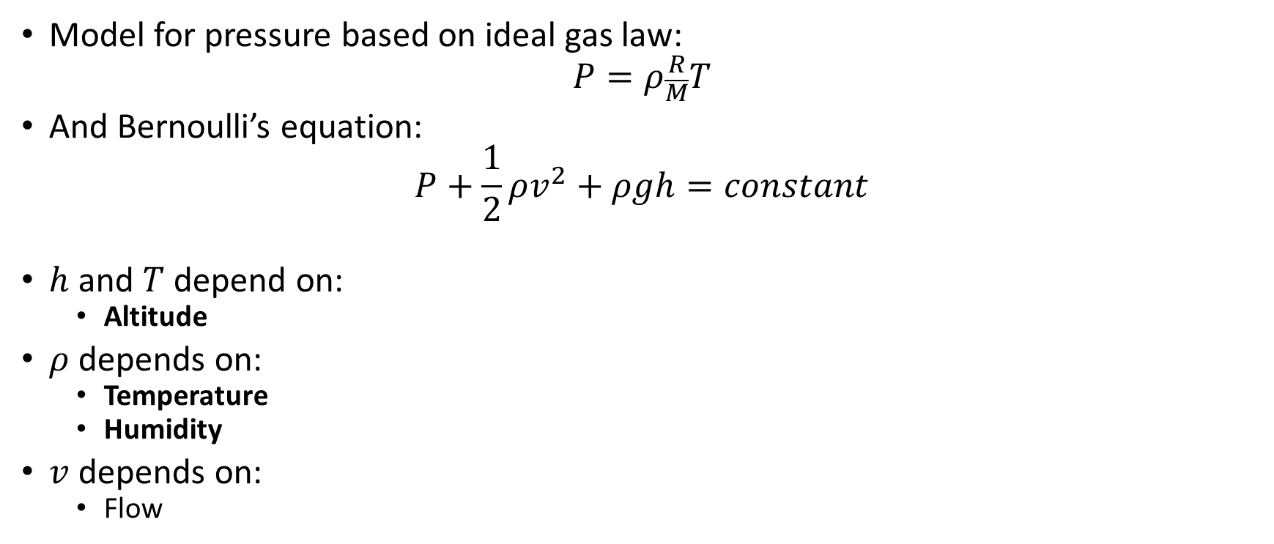
Air pressure
Model for pressure based on ideal gas law:
$$P=ρ\frac{R}{M}T$$
And Bernoulli’s equation:
$$P+\frac{1}{2}ρv^{2}+ρgh=constant$$
$h$ and $T$ depend on:
Altitude
$ρ$ depends on:
Temperature
Humidity
$v$ depends on:
Flow

Slide 5
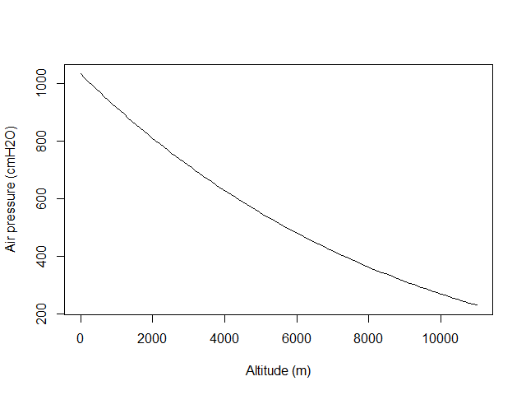
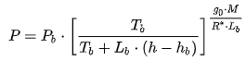
Altitude Barometric formula
Around sea-level, an increase of 100 m in altitude corresponds to a decrease of 12 cmH2O in air pressure.
Notes:
https://en.wikipedia.org/wiki/Barometric_formula#Derivation

Slide 6
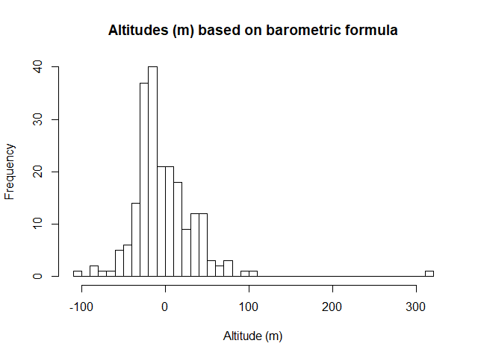
Altitude Barometric formula
Notes:
https://en.wikipedia.org/wiki/Barometric_formula

Slide 7
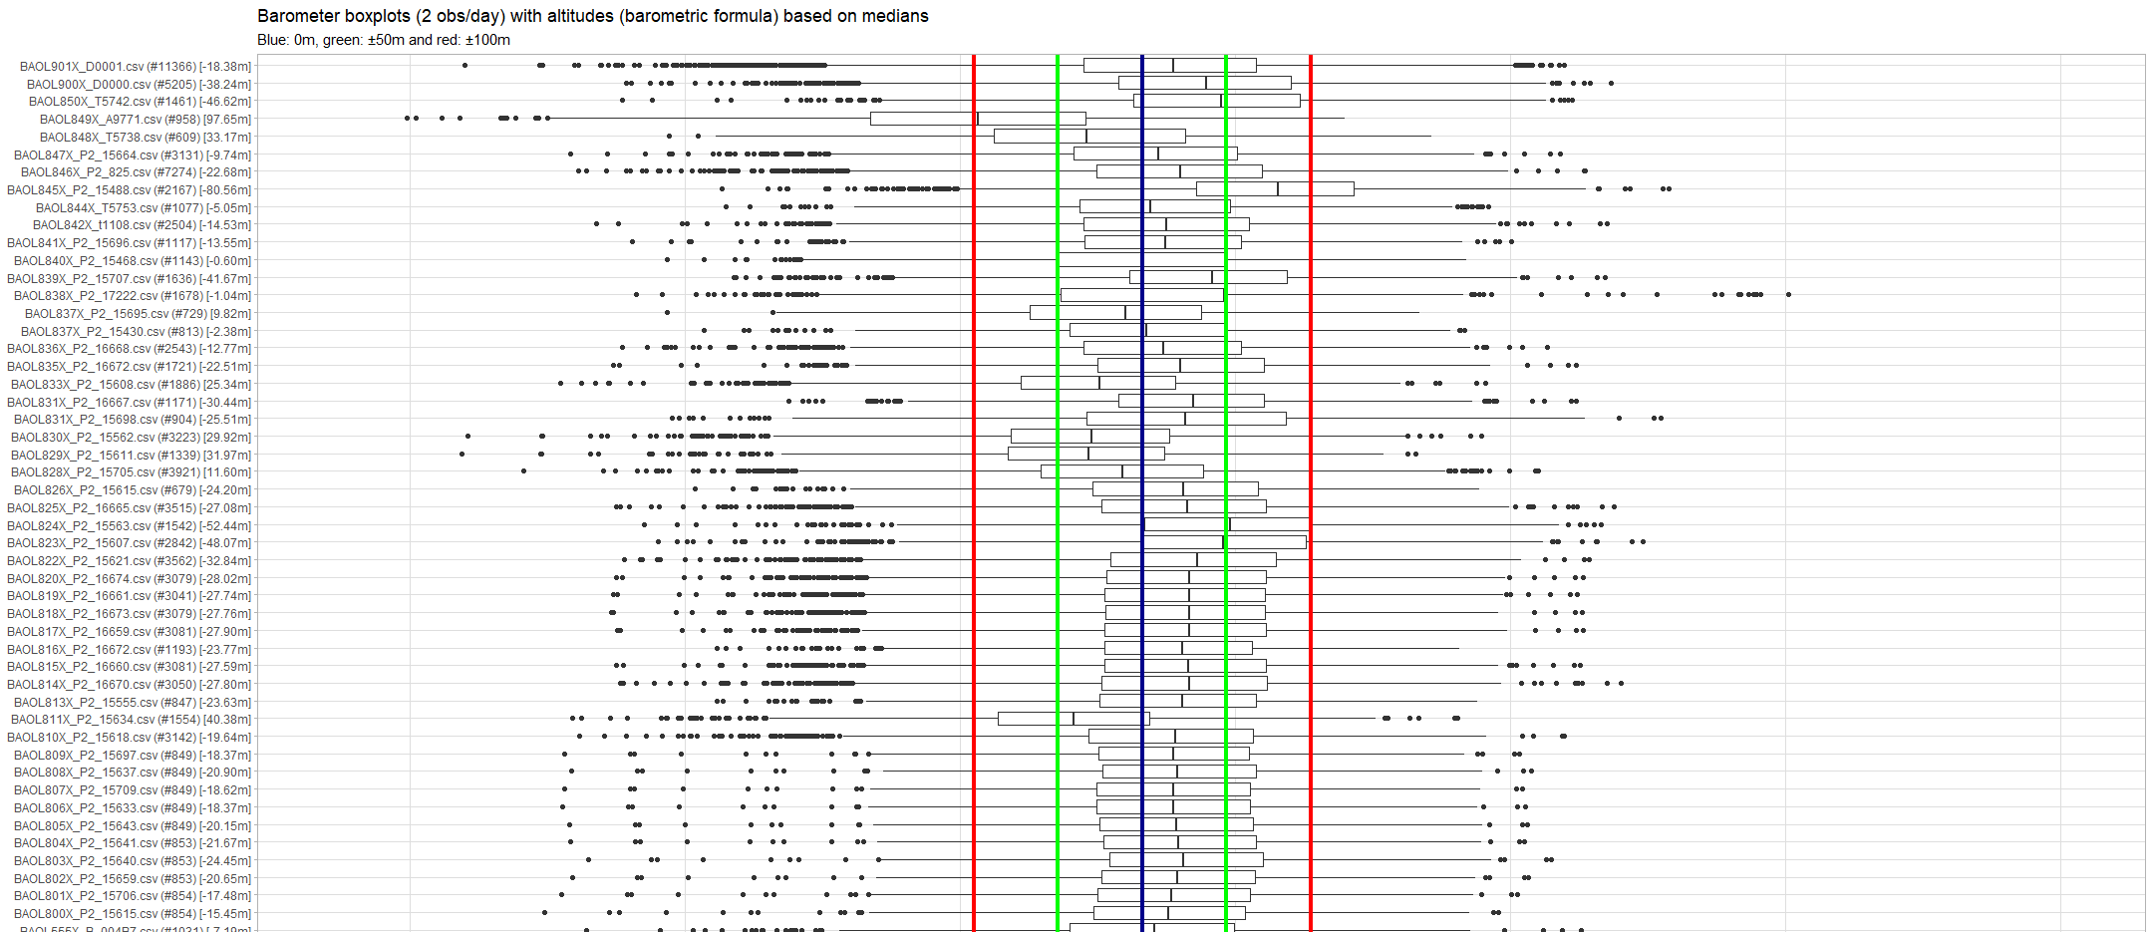
Altitude Barometric formula
Notes:
https://en.wikipedia.org/wiki/Barometric_formula

Slide 8
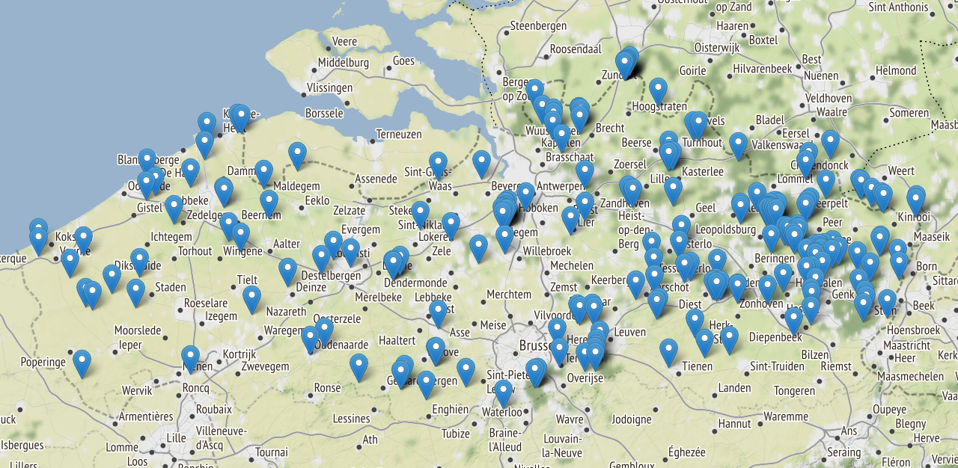
Barometer altitude
Notes:
Can be extracted with e.g. Google Elevation API for comparison.

Slide 9
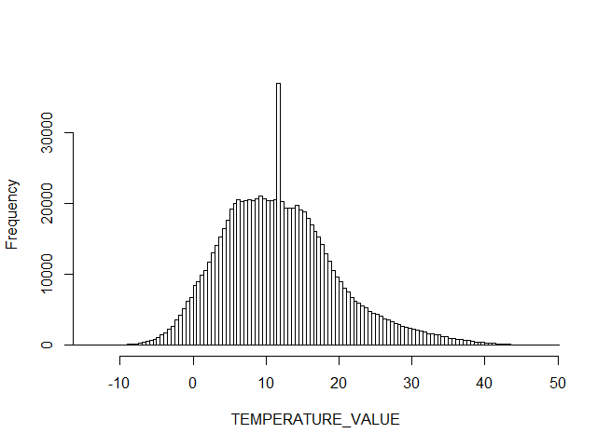
Temperature Data analysis
Temperature distribution of all barometers.

Slide 10
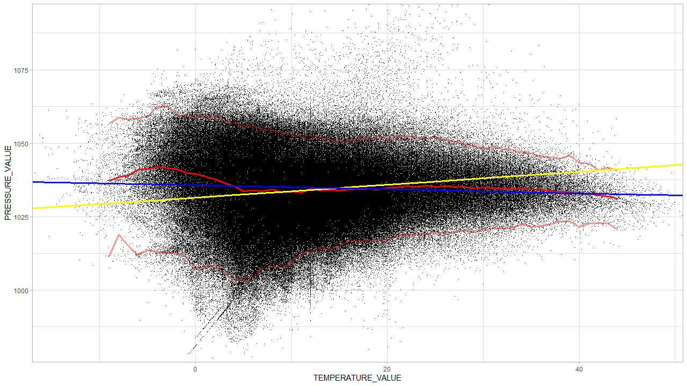
Temperature Data analysis
Raw data: BAOL016X_W1666.csv and BAOL050X_56819.csv excluded.
Notes:
Blue line is the median regression.

Slide 11
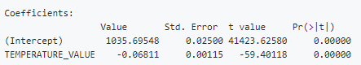
Temperature Data analysis
Notes:
Blue line is the median regression. Yellow is OLS: might be influenced by outliers.

Slide 12

Temperature Theory
$$P=ρ\frac{R}{M}T$$
Both $ρ$ and $T$ are unknown (and interdependent)
We have only one equation
For discussion, see here
Theoretical effect of local temperature change on air pressure unknown. More research needed.

Slide 13
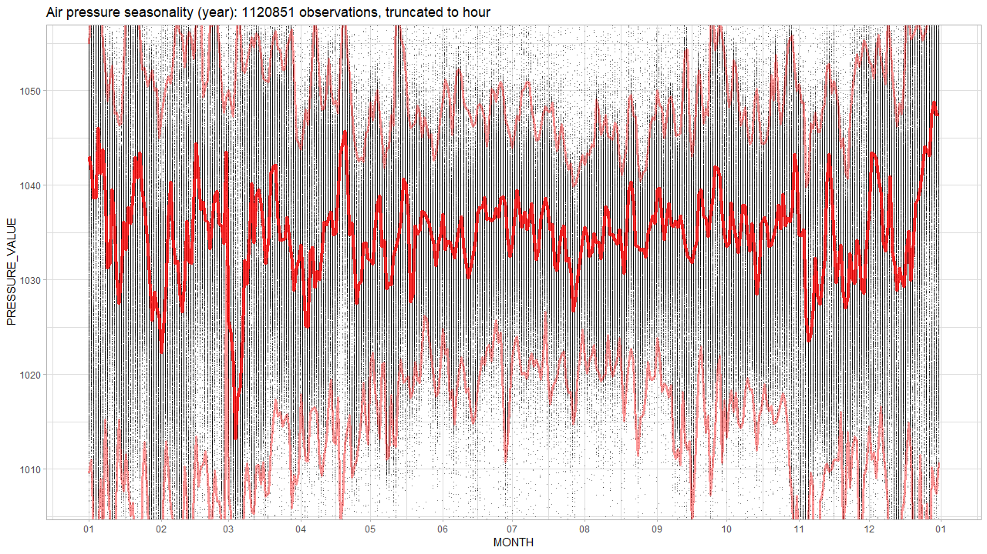
Temperature Data analysis
The bulge? Seasonal?
Notes:
Blue line is the median regression.

Slide 14
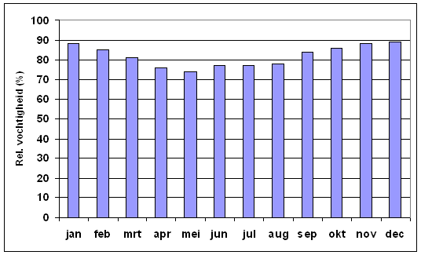
Humidity Data analysis
Bulge due to high humidity?

Slide 15
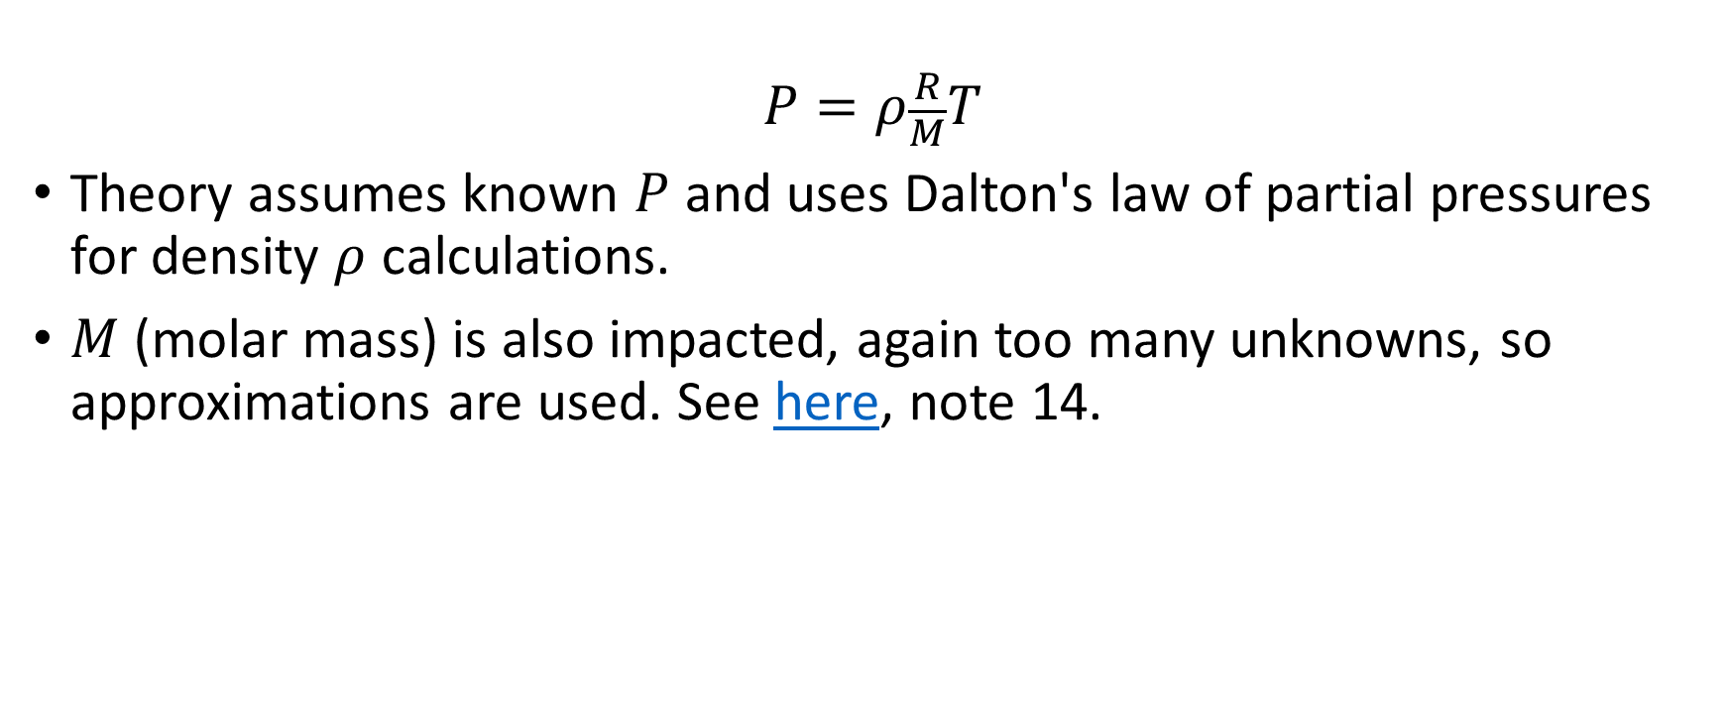
Humidity Theory
$$P=ρ\frac{R}{M}T$$
Theory assumes known $P$ and uses Dalton's law of partial pressures for density $ρ$ calculations.
$M$ (molar mass) is also impacted, again too many unknowns, so approximations are used. See here, note 14.
Theoretical effect of humidity on air pressure unknown. More research needed.

Slide 16
Summary
Altitude
Effect is significant: 12 cmH2O per 100m.
Temperature: effect unknown
Data analysis suggests 0,07 cmH2O drop per 1 °C. Over the observed range [-10, 50] °C this amounts to 4 cmH2O change.
Humidity: effect unknown
Seasonality analysis shows humidity has no impact on mean air pressure.
Humidity might be causing more lower pressure observations during non-summer time. (i.e. the bulge around 5 °C)

Slide 17
Barometer drift analysis
Theory and results

Slide 18

Ideal situation: 2 barometers side by side
$X_{t}=μ_{t}+ε_{X}$ and $Y_{t}=μ_{t}+ε_{Y}$
Subtract yields:
$$X_{t}−Y_{t}=ε_{X}−ε_{Y}=ε_{XY}∼N(0, σ_{X}^{2}+σ_{Y}^{2})$$
Notes:
Neem aan dat epsilons normal verdeeld zijn.

Slide 19
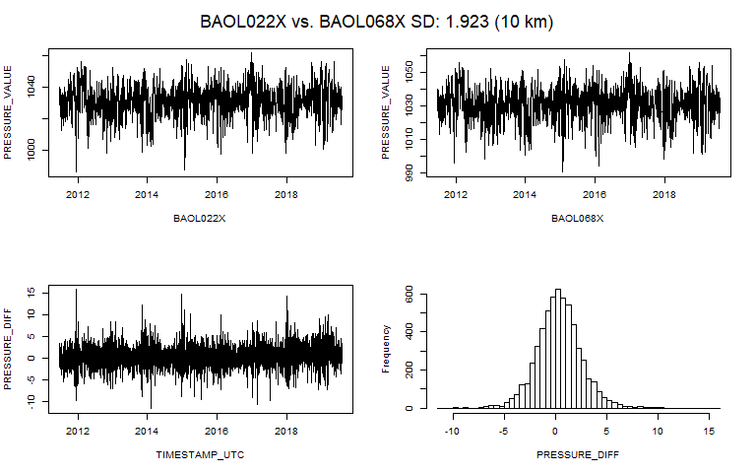
Pairwise comparison Two barometers close to each other.
At 11m and 13m altitude? So differences are white noise around 0 cmH2O.
Notes:
At 11m and 13m altitude.

Slide 20
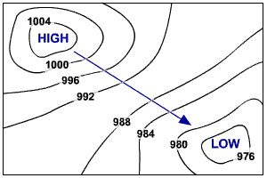

Situation: 2 barometers at a distance
$$X_{t}=μ_{t}+ε_{X}$$
and
$$Y_{t}=μ_{t}+ε_{Y}+ε_{d(X,Y)}$$
Subtract yields:
$$X_{t}−Y_{t}=ε_{XY}+ε_{d(X,Y)}$$
$$∼N(0, {σ_{X}^{2}+σ_{Y}^{2}+σ}_{ d(X,Y)}^{2})$$

Slide 21
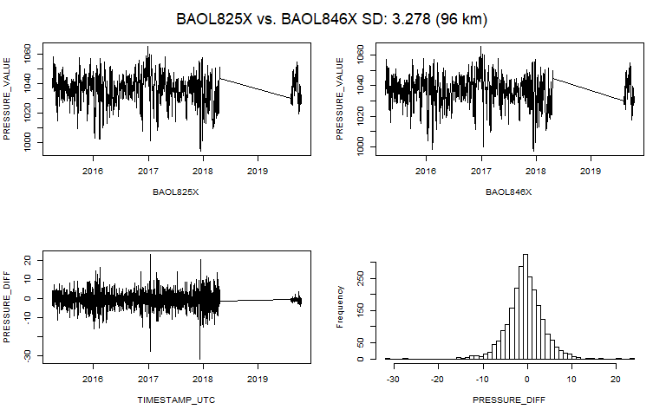
Pairwise comparison Two barometers close to each other.
At -27m and -23m altitude? So differences are white noise around 0 cmH2O.
Notes:
At 11m and 13m altitude.

Slide 22
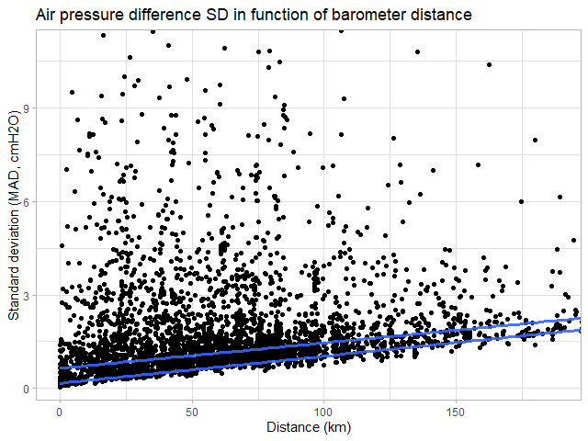
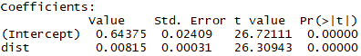
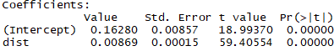
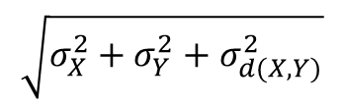
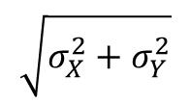
Pairwise comparison SD (MAD) of pressure differences (cmH2O) vs distance (km): Q50 and Q10
$$\sqrt{σ_{X}^{2}+σ_{Y}^{2}}$$
$$\sqrt{σ_{X}^{2}+σ_{Y}^{2}+σ_{d(X,Y)}^{2}}$$

Slide 23
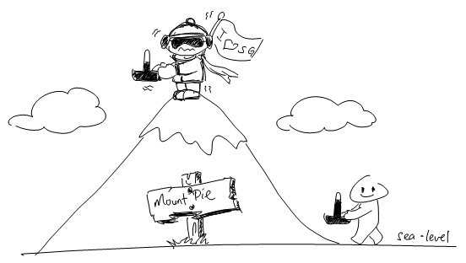
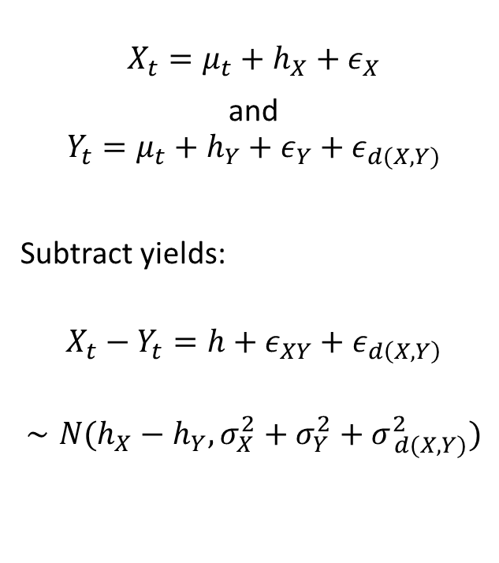
Situation: 2 barometers at a distance and different altitude
$$X_{t}=μ_{t}+h_{X}+ε_{X}$$
and
$$Y_{t}=μ_{t}+h_{Y}+ε_{Y}+ε_{d(X,Y)}$$
Subtract yields:
$$X_{t}−Y_{t}=h+ε_{XY}+ε_{d\left(X,Y\right)}$$
$$∼N(h_{X}−h_{Y}, {σ_{X}^{2}+σ_{Y}^{2}+σ}_{ d(X,Y)}^{2})$$

Slide 24
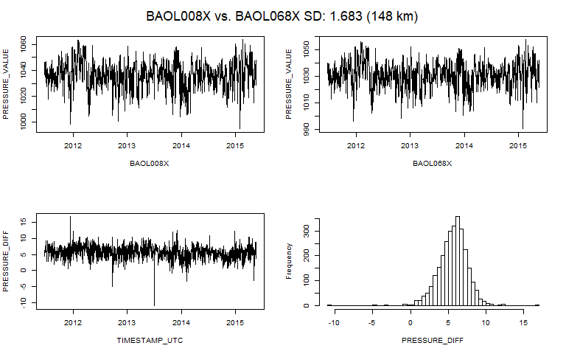
Pairwise comparison Two barometers far from each other.
At -32m and 13m altitude? So differences are white noise around 6 cmH20.

Slide 25
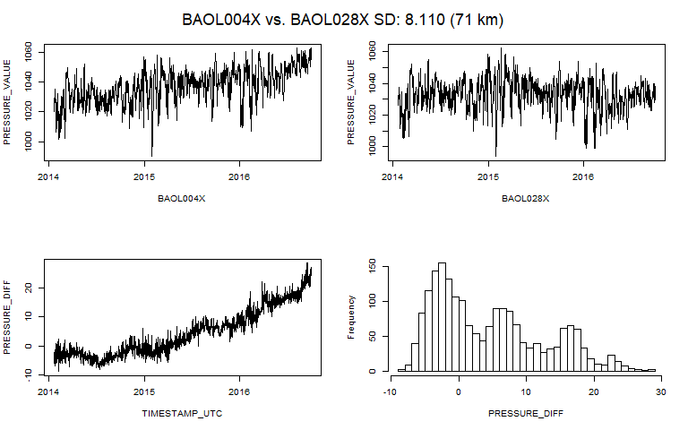
Pairwise comparison Two barometers while one drifting: high SD
Very high SD due to drift.
Notes:
Als nodig, dan kan ik die plots nog verbeteren… want in analyse 02 is matching niet optimaal.

Slide 26
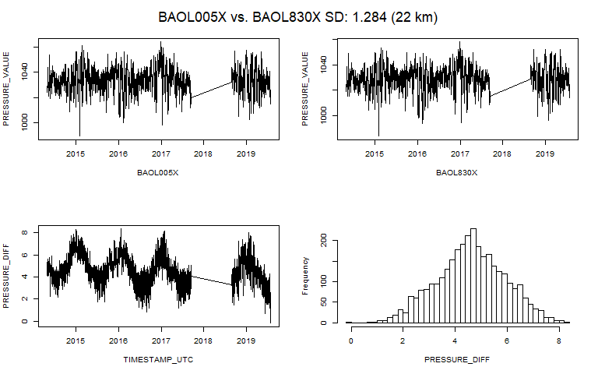
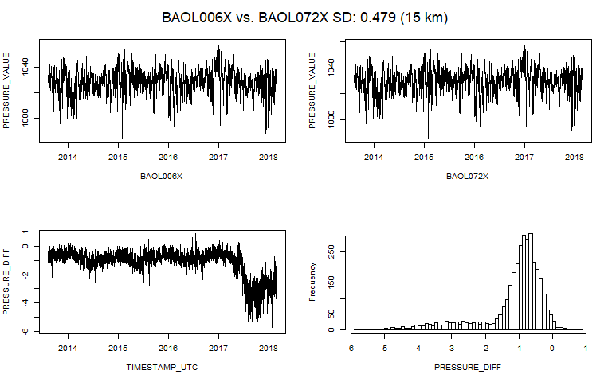
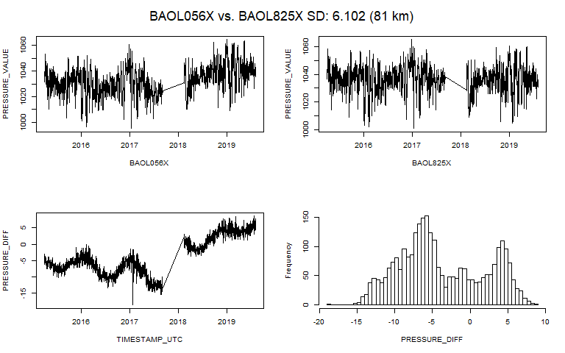
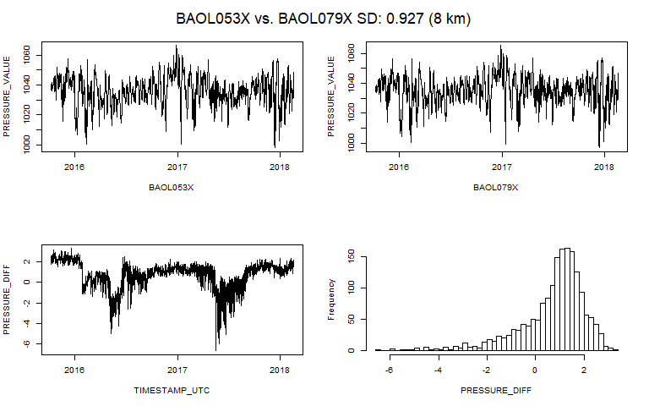
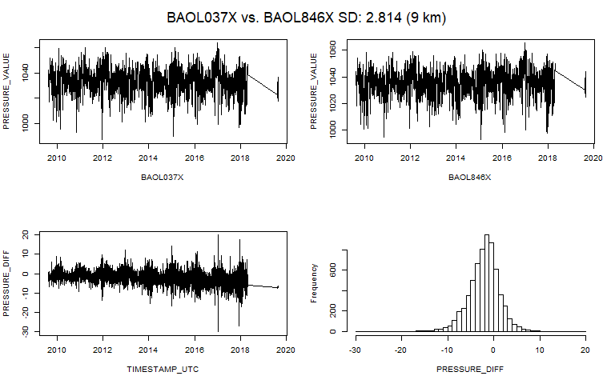
Pairwise comparison Problems

Slide 27
Pairwise comparison Conclusion
They do not tell us which one is drifting,
If they both drift the same way, we do not even see it.

Slide 28

Situation: multiple barometers at a distance and different altitude
$$X_{t}=μ_{t}+h_{X}+ε_{X}$$
and
$$Y_{i,t}=μ_{t}+h_{Y_{i}}+ε_{Y_{i}}+ε_{d(X,Y_{i})} Y_{i}∈ℬ ∖ X$$
Subtract yields:
$X_{t}−Y_{1,t}=h_{X}−h_{Y_{1}}+ε_{XY}+ε_{t, d\left(X,Y_{1}\right)}$ $∼N(h_{X}−h_{Y_{1}}, {σ_{X}^{2}+σ_{Y}^{2}+σ}_{ d(X,Y_{1})}^{2})$
$X_{t}−Y_{2,t}=h_{X}−h_{Y_{2}}+ε_{XY}+ε_{t, d\left(X,Y_{2}\right)}$ $∼N(h_{X}−h_{Y_{2}}, {σ_{X}^{2}+σ_{Y}^{2}+σ}_{ d(X,Y_{2})}^{2})$
$$⋮$$
$X_{t}−Y_{n,t}=h_{X}−h_{Y_{n}}+ε_{XY}+ε_{t, d\left(X,Y_{n}\right)}$ $∼N(h_{X}−h_{Y_{n}}, {σ_{X}^{2}+σ_{Y}^{2}+σ}_{ d(X,Y_{n})}^{2})$
Notes:
Als hier nu een paar Yi fout zijn, maar de meeste Yi juist zijn, dan zouden die paar foute geen al te grote

Slide 29
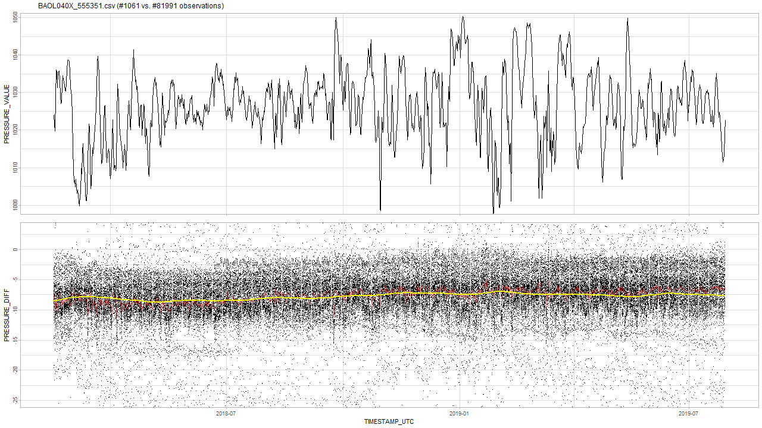
Multi comparison One barometer vs all the rest

Slide 30
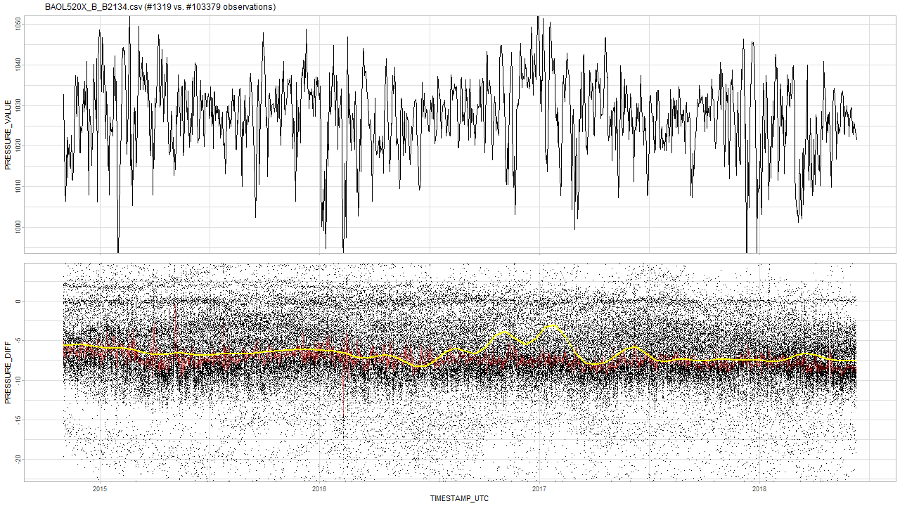
Multi comparison One barometer vs all the rest

Slide 31
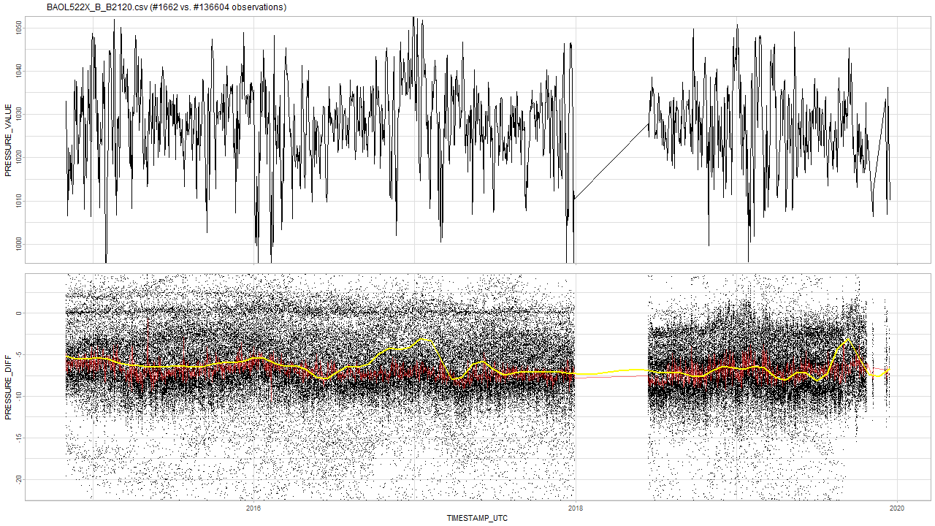
Multi comparison One barometer vs all the rest

Slide 32
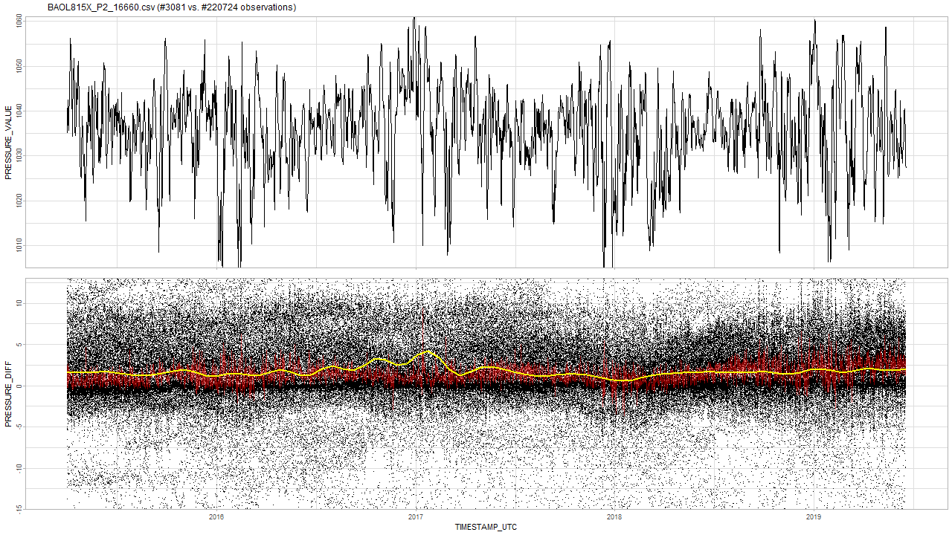
Multi comparison One barometer vs all the rest

Slide 33
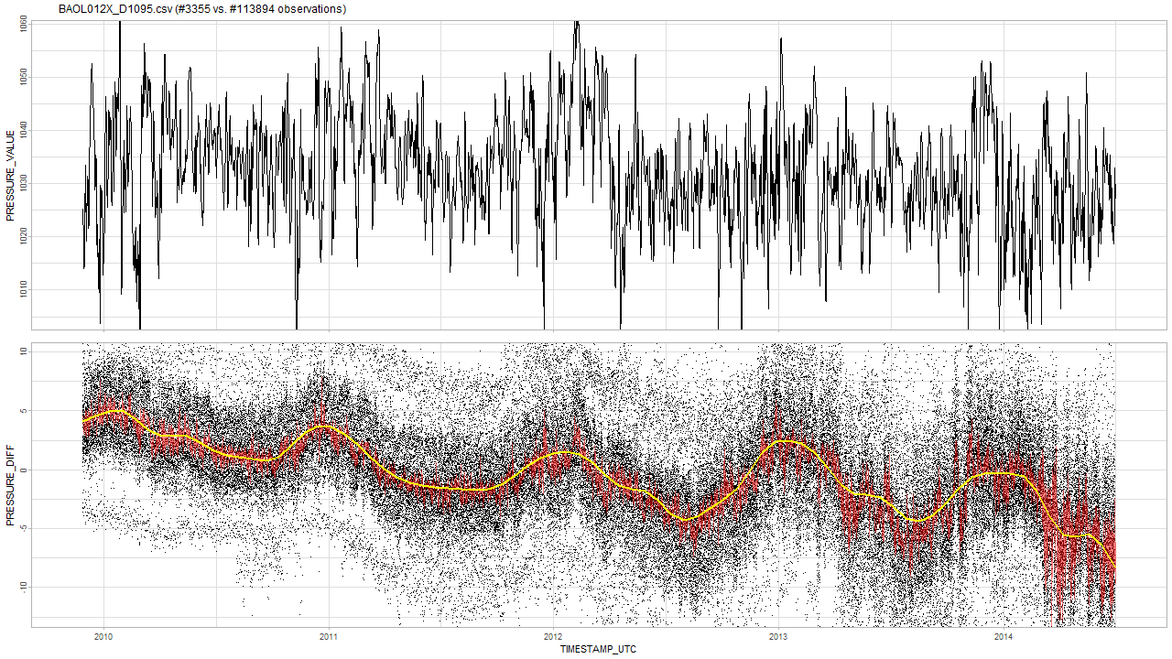
Multi comparison One barometer vs all the rest

Slide 34
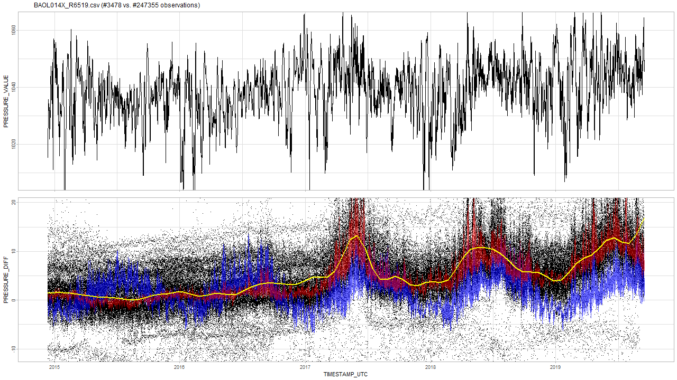
Multi comparison One barometer vs all the rest
Temperature pattern in blue: positively correlated.

Slide 35
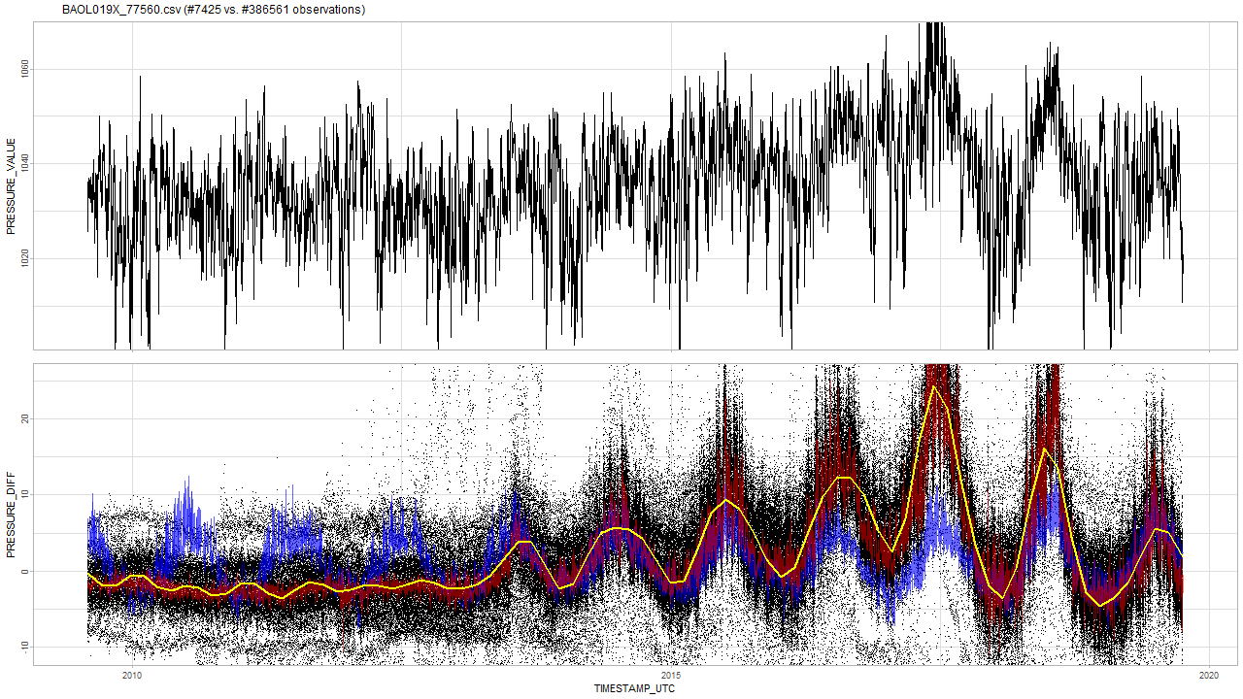
Multi comparison One barometer vs all the rest
You never see barometers first oscillating and then stabilizing.
Notes:
Feit dat ze altijd naar het einde toe oscilleren weerlegt een mogelijk argument dat de baro’s in andere tijdenlijk andere weeromstandigheden staan.

Slide 36
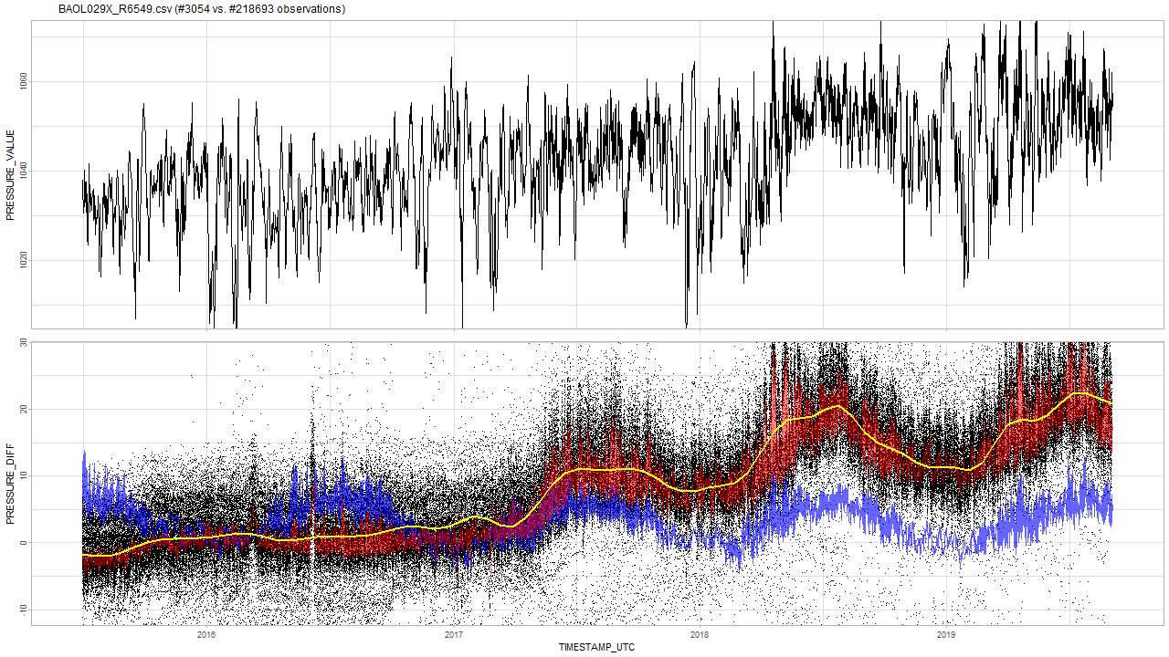
Multi comparison One barometer vs all the rest

Slide 37
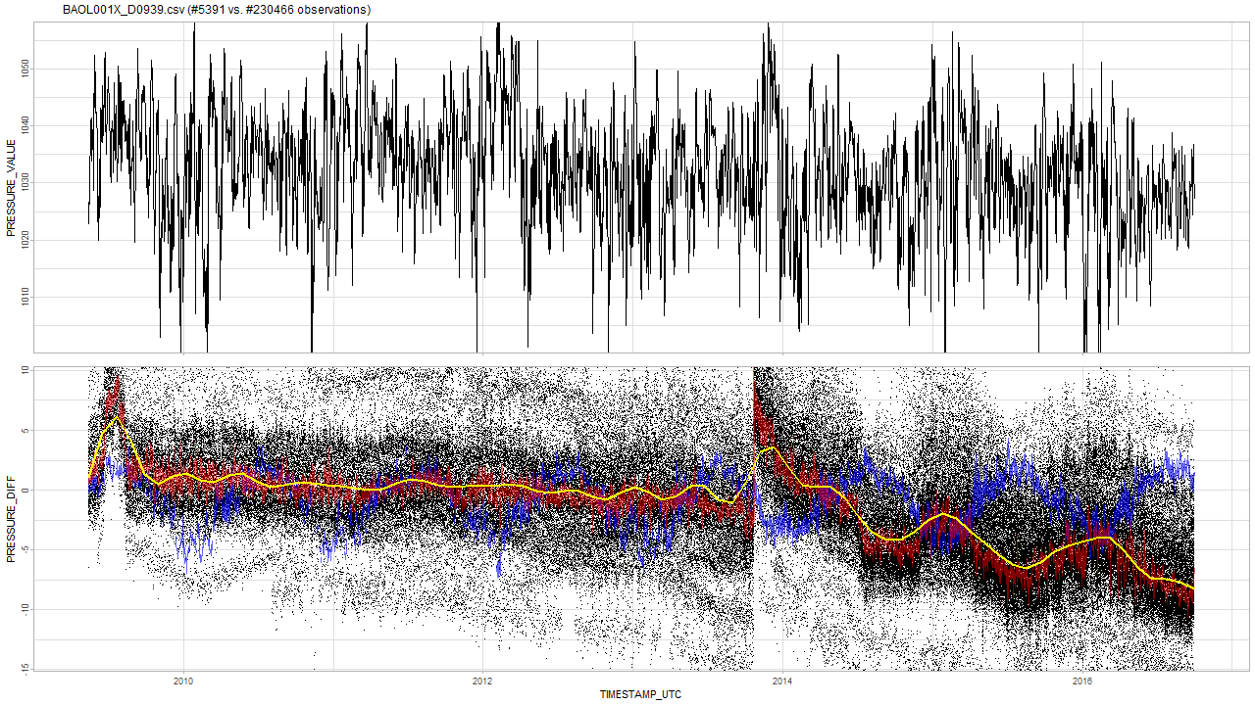
Multi comparison One barometer vs all the rest
Temperature pattern in blue: negatively correlated.

Slide 38
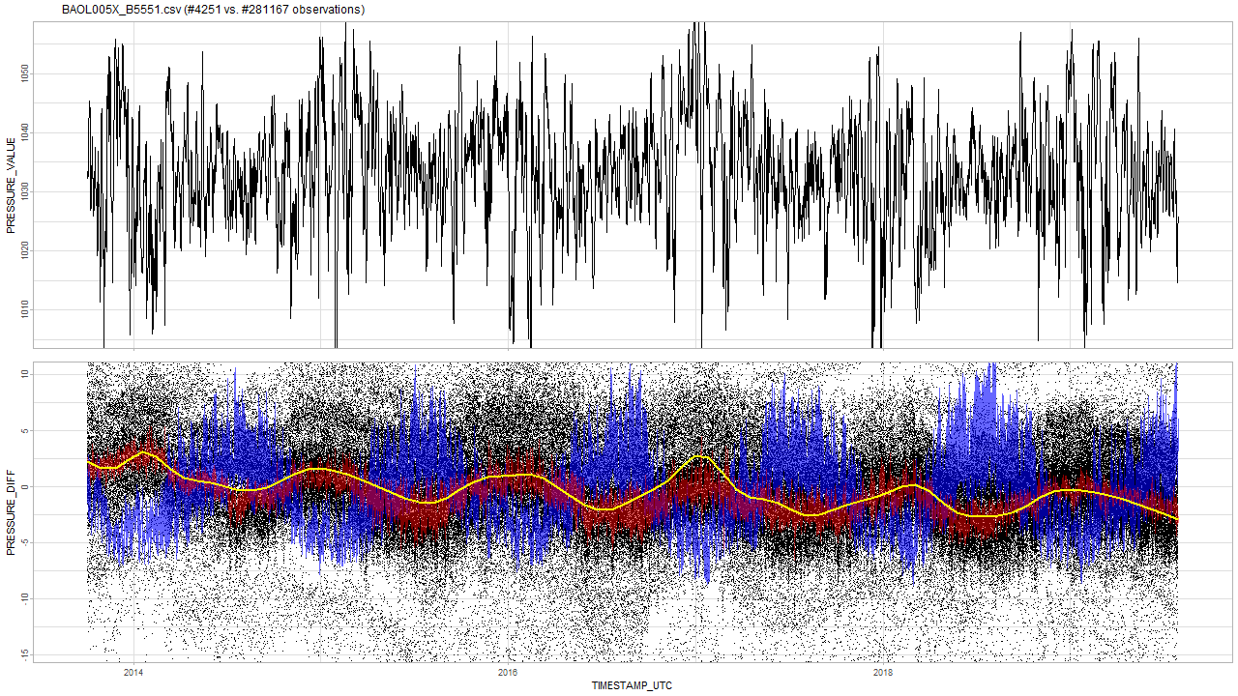
Multi comparison One barometer vs all the rest

Slide 39
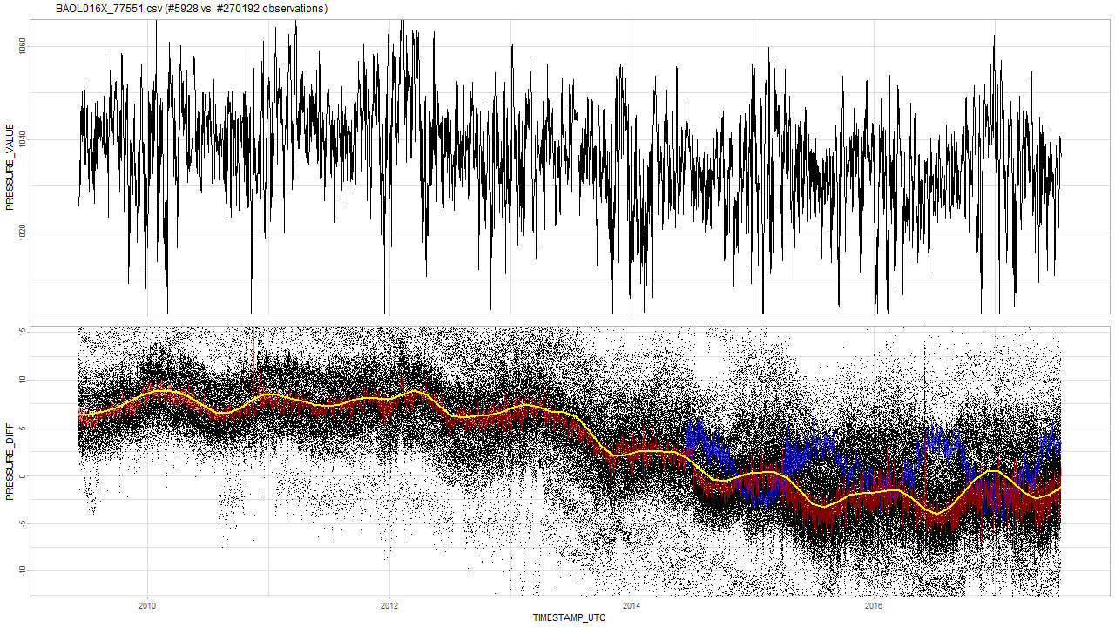
Multi comparison One barometer vs all the rest

Slide 40
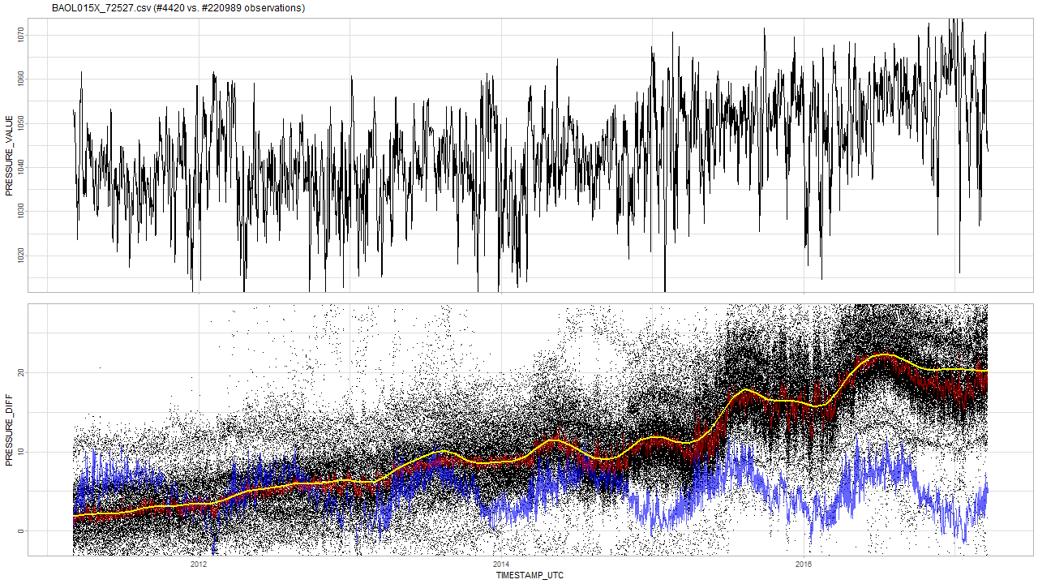
Multi comparison One barometer vs all the rest
Sometimes negative, sometimes positive correlation?

Slide 41
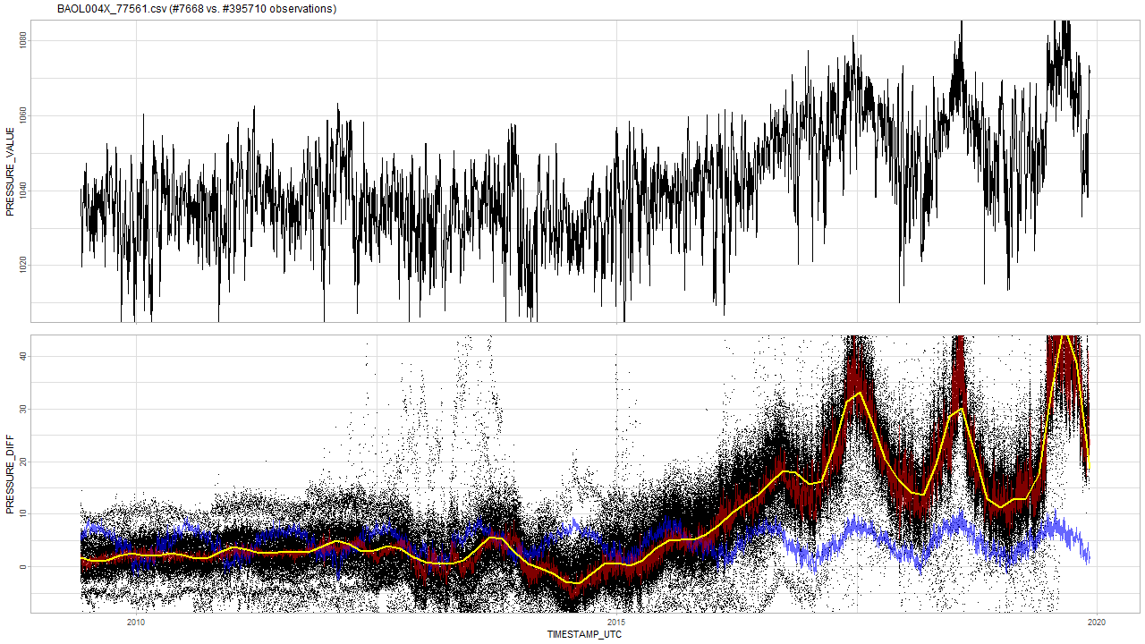
Multi comparison One barometer vs all the rest
Temperature peaks not in sync at the end.

Slide 42
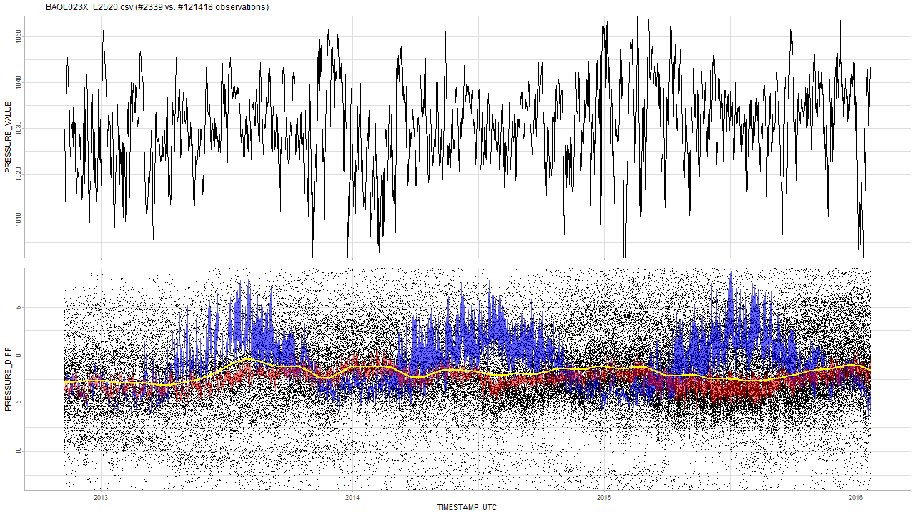
Multi comparison One barometer vs all the rest
This one is still good.

Slide 43
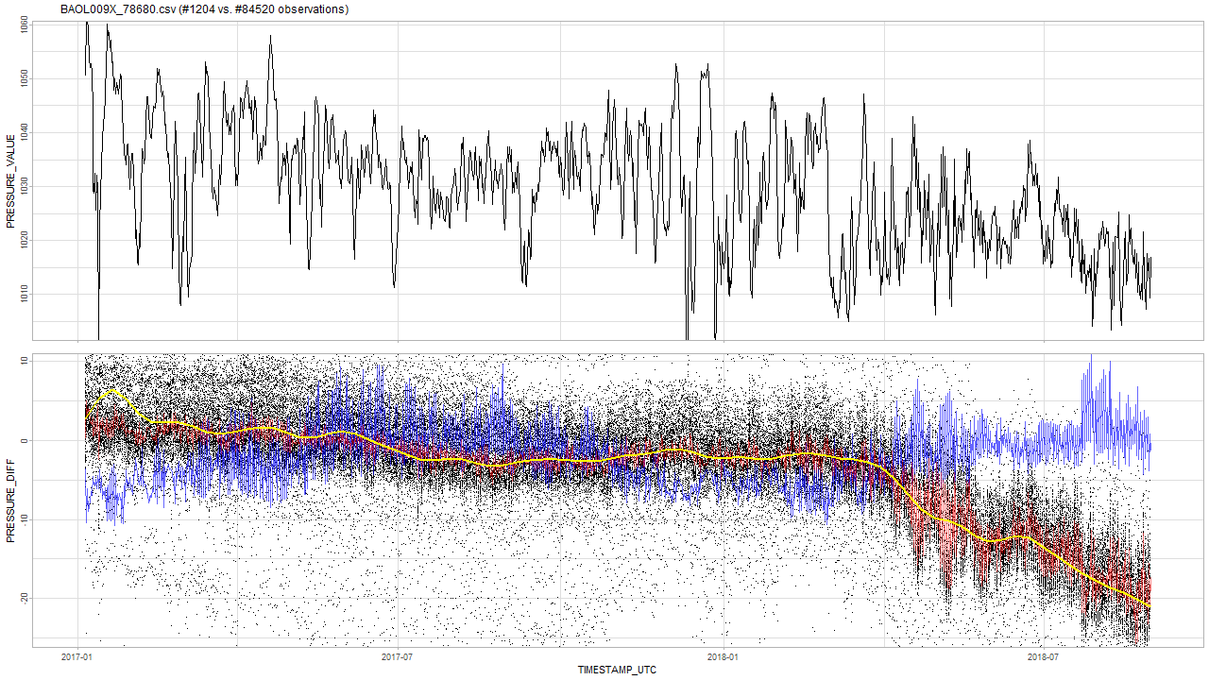
Multi comparison One barometer vs all the rest

Slide 44
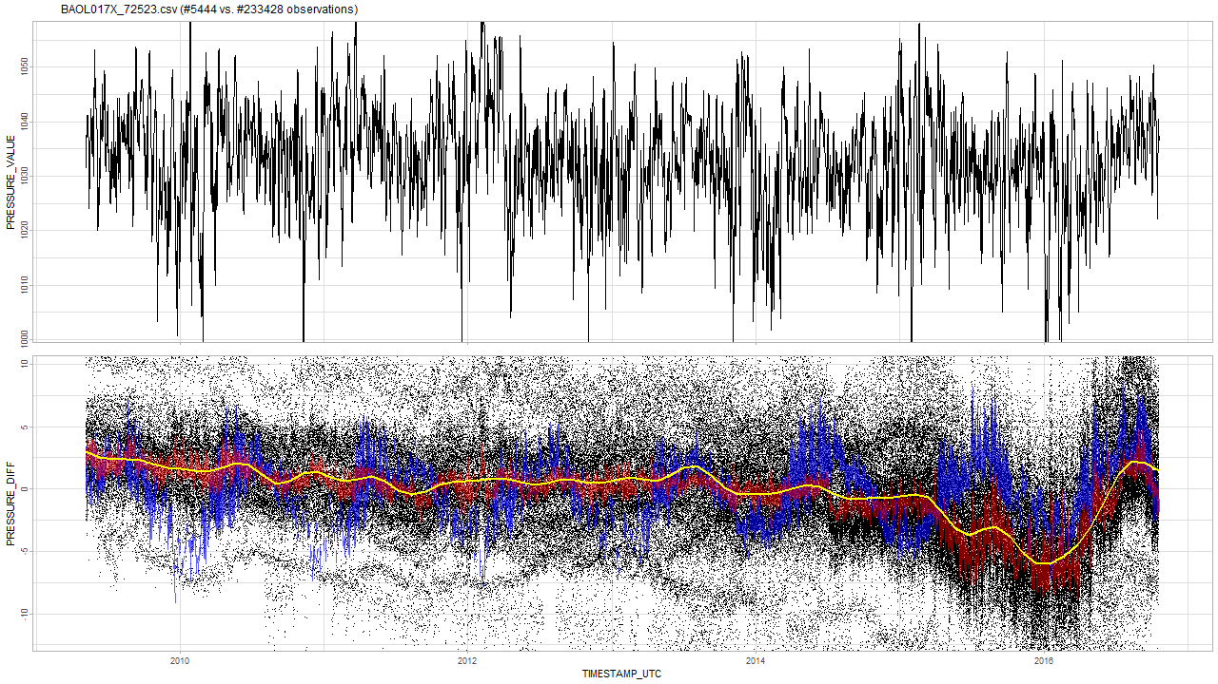
Multi comparison One barometer vs all the rest

Slide 45
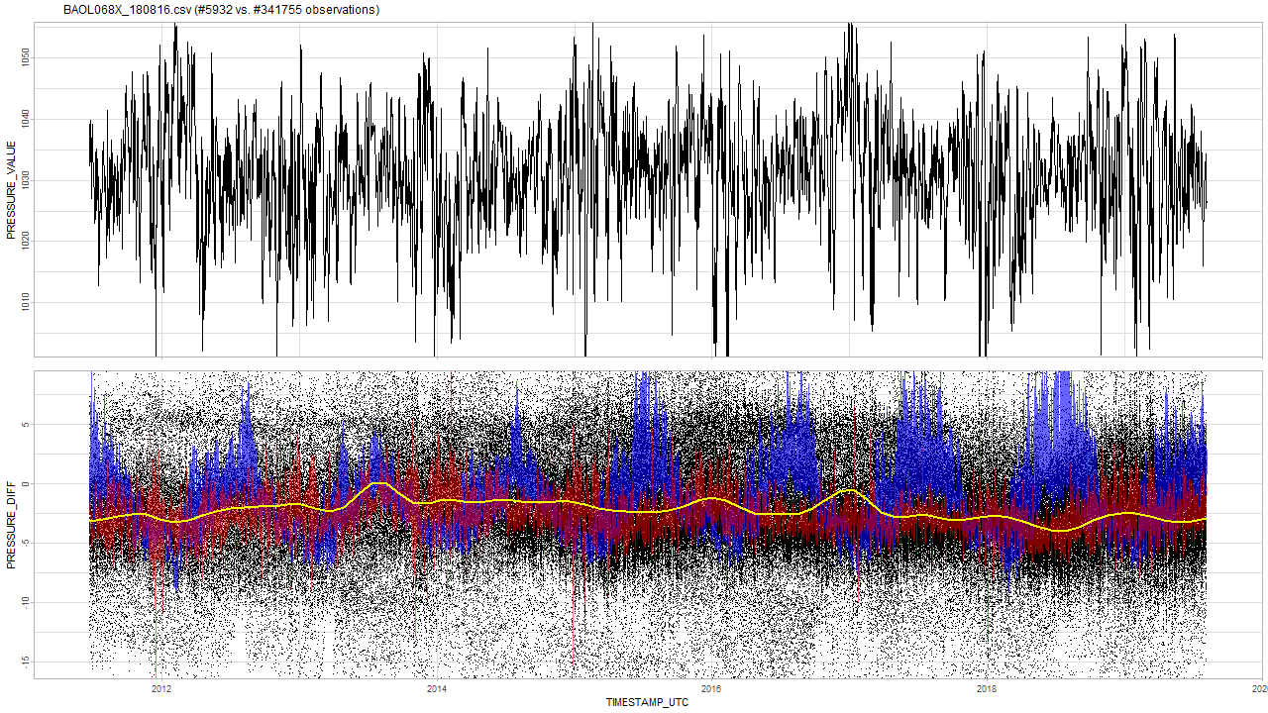
Multi comparison One barometer vs all the rest
Old but also still good.

Slide 46

Multi comparison One barometer vs all the rest

Slide 47

Multi comparison One barometer vs all the rest

Slide 48

Multi comparison One barometer vs all the rest

Slide 49

Multi comparison One barometer vs all the rest

Slide 50

Multi comparison One barometer vs all the rest

Slide 51

Multi comparison One barometer vs all the rest

Slide 52

Multi comparison One barometer vs all the rest
Very old but still “OK”? The oscillations are not all that big. Why?

Slide 53

Multi comparison One barometer vs all the rest

Slide 54

Multi comparison One barometer vs all the rest

Slide 55

Multi comparison One barometer vs all the rest
Where will it end?

Slide 56

Multi comparison One barometer vs all the rest
What happened?

Slide 57

Multi comparison One barometer vs all the rest
Calibration test could verify this one is too low currently?

Slide 58

Multi comparison One barometer vs all the rest
This one “was” new? Now unstable?

Slide 59

Multi comparison One barometer vs all the rest
Unstable?

Slide 60

Multi comparison One barometer vs all the rest
Unstable?

Slide 61

Multi comparison One barometer vs all the rest
Unstable?

Slide 62

Multi comparison One barometer vs all the rest
Unstable?

Slide 63

Multi comparison One barometer vs all the rest
Unstable?

Slide 64

Multi comparison: remarks
Universal way of matching barometers on timestamps.
Truncation: 12h
E.g. observation at 2019-02-02 13:05:00 UTC is truncated to 2019-02-02 12:00:00 UTC
Averaging over truncated values.
Missing values for barometers are a potential problem.
E.g. for 2020, if there is no barometers available for comparison, or if there is only a limited number of barometers available?
Seems many barometers become sensitive to temperature changes after x years?
No clear temperature dependence pattern.
Many barometers seem broken? Median assumes about 50 % non-broken.
After BAOL1XX less drifting cases but more unstable cases?
Some are just unstable? (i.e. not drifting)
Mostly BAOL5XX

Slide 65

Next steps
Continue “multi-comparison” analysis?
Try removing altitude-effect for better comparison? (e.g. remove $h_{X}$ and $h_{Y}$)
Compare altitudes based on barometric formula with real elevation based on the coordinates
…?
First algorithm: detect trend $α≠0$ for some structural break at $t_{b}$ for model $y=c+αtI\left(t>t_{b}\right)+ε$
detect_drifts(x, other)
Need enough “other” data to compute “x”. Problem: what is enough?
Detect any significant change in trend $α$ after $t_{b}$.
detect_drifts(x)
Can be based on apriori data about $α$. If trend $α$ is larger than the worst case in apriori data, then flag from $t_{b}$.
detect_drifts(x, altitude)
…?

Slide 66

Next steps: potential problems
How certain are we that barometers from analysis 04 are broken?
Unstable barometers: detecting change after $t_{b}$ with $α≠0$ is difficult.

Slide 67


Questions?
Frederic: question from GitHub solved?
Frederic: “Typically one Barologger can cover a radius of 30 km (20 mile) and/or every 300 m (1000 ft) elevation change.”
Radius 30 km: error SD increase with 0,3 cmH2O (analysis)
Elevation change of 300 m: 36 cmH2O change in mean (barometric formula)
Piet: hydrostatic error: 2 cmH2O.
For baro’s from analysis of median: 1,3 cmH2O
After about 100km the error is also 2 cmH20 due to distance.
Piet: -20 tot 50 °C: effect?
Effect based on analysis: 70 * 0,068 = 4,8 cmH2O

Slide 68
The End

Slide 69
Sprint 6
gwloggeR v0.1.5

Slide 70
Agenda
gwloggeR website
User guide
Algorithm documentation
v0.1.5
Development guide
Next steps
Notes:
Vraag sprint 4: kunnen we in de resterende tijd iets maken dat tsoutliers-beperkingen omzeilt: vervolg is samenvatting van mijn poging.

Slide 71

gwloggeR: website

Slide 72

gwloggeR: getting started manual

Slide 73

gwloggeR: air pressure vignette

Slide 74

gwloggeR: hydrostatic pressure vignette

Slide 75

gwloggeR: v0.1.5

Slide 76

gwloggeR: development guide

Slide 77
Next Steps
See future work:
General
Air pressure
Hydrostatic pressure

Slide 78
The End

Slide 79
Sprint 5
Hydrostatic pressure AO, LS and TC detection

Slide 80
Agenda
Theoretical underpinnings:
Custom AO, LS and TC hydrostatic pressure detection
v0.05 (AO and LS detector)
v0.06 (AO, LS and TC detector)
Next steps
Notes:
Vraag sprint 4: kunnen we in de resterende tijd iets maken dat tsoutliers-beperkingen omzeilt: vervolg is samenvatting van mijn poging.

Slide 81
Theoretical underpinnings
Hydrostatic pressure AO, LS and TC detection

Slide 82


Model: $z_{t}=z_{t−1}+ε$
DYLP126X_F6843.csv
Notes:
Assumptie: simple first order diff model

Slide 83

Differences: $z_{t}−z_{t−1}=ε$
Notes:
How is epsilon distributed?

Slide 84


Differences: $z_{t}−z_{t−1}=ε$
$$Δt=1 day$$
Notes:
Normal? Something else?

Slide 85



Observation: $z_{t}−z_{t−1}=ε(Δt)$
Main observation is that $ε$ is strongly influenced by $Δt$
So we assume $ε$ is a function of $Δt$
-> How do we estimate $ε(Δt)$?
Notes:
Big observation is that epsilon is a function of time: hoe plausible is het dat er na zo veel tijd zo’n grote jump is?

Slide 86


A-priori hydrostatic pressure data for $ε(Δt)$ estimation
Raw Geotech 5min and 15min $Δt$ data: link (29 timeseries).

Slide 87
Why not subsample intervals?
Problem
In case of very large intervals (e.g. month or more): only a few samples
Subsampling
Intuitively: not how a real logger works.
Independence assumption: does not work in case of subsampling.

Slide 88


Density of $ε(Δt)$

Slide 89


Median and 0.975 quantile of abs($ε(Δt)$)

Slide 90







Distribution of $ε(Δt)$
$$Δt=1 hour$$
$$Δt=5 min$$
$$Δt=12 hour, 25 min$$
Removing tidal effect results in quasi-normality?
Notes:
Eens tidal effect is uitgefilterd lijkt het vrij normaal!
Now that we have the distribution we can start detecting:

Slide 91



Detection based on a-priori information: $$z_{t}−z_{t−1}=ε(Δt)$$
Outlier according to $ε\left(Δt\right)$ function.

Slide 92


ToDo
Threshold for $ε(Δt)$ is currently min/max value + 10 %.
This is Q&D because the distribution is unknown.
Should be improved in the future, especially once tidal effect is removed and normality is attained?
$$Δt=5 min$$

Slide 93


Outliers on a-priori $ε(Δt)$ can have different interpretations
Still looking for more simple formalization methods.
LS (level shift)
$$z_{t}=z_{t−1 }+ε\left(Δt\right)+α⋅I(t=t_{LS})$$
AO (additive outlier)
$$z_{t}=z_{t−1 }+ε\left(Δt\right)+α⋅[I\left(t=t_{AO}\right)−I(t=t_{AO}+1)]$$
TC (temporal change)
$$z_{t}=z_{t−1 }+ε\left(Δt\right)+α⋅[ I\left(t=t_{TC}\right)+\left(δ^{1}−δ^{0}\right)⋅I\left(t=t_{TC}+1\right)+…]$$
Notes:
Ben nog aan het zien naar betere/simpelere formalisatiemethode…

Slide 94

How determine whether $ε(Δt)$ outliers is AO, LS or TC?
Engineering approach
Simple at first sight, but becomes quite complex once special cases or TC is added
Not a real option
Statistical approach
Likelihood function needed
3 contenting models for each point AO, LS and TC

Slide 95

How determine whether $ε(Δt)$ outliers is AO, LS or TC?
Statistical approach
Likelihood function needed
Needs to be optimized
Convexity of likelihood function?
$ε(Δt)$ approximation with kernel: non-convex likelihood guaranteed = BAD
$ε(Δt)$ approximation with normal density: mostly convex likelihood = OK
3 contenting models for each point AO, LS and TC
# parameters in full model is unknown at start
Stepwise (forward and backward) model selection
Model fit based on likelihood ratio (LR) test
Notes:
We schatten dus epsilon(delta-t) op basis van normaliteit omdat de kans kleiner is dat we dan in een locale minima belanden.

Slide 96

AO, LS, TC detection algorithm summary
Compute $z_{t}−z_{t−1}$ and $Δt$’s
Compute $ε(Δt)$ thresholds for each $t$
Extract $t$’s which are candidates for AO, LS, TC
Iterate over all possibilities ($t$, AO, LS, TC)
Compute likelihood
Test significance with LR-test and degrees of freedom (DF):
AO, LS = 1DF, TC = 2DF
Nothing more significant: $break()$
Report
type index alpha delta
1: AO 10824 -108.0 NA
2: AO 17175 -91.5 NA
3: LS 22552 -80.0 NA

Slide 97




Example: Geotech v0.05
type index alpha delta
1: AO 10824 -108.0 NA
2: AO 17175 -91.5 NA
3: LS 22552 -80.0 NA
Notes:
type index alpha delta
1: AO 10824 -108.0 NA
2: AO 17175 -91.5 NA
3: LS 22552 -80.0 NA

Slide 98


Example: Geotech v0.05
AO and LS at the same time.
Notes:
type index alpha delta
1: AO 3968 -363.446 NA
2: AO 13555 -164.792 NA
3: AO 14117 -351.283 NA
4: AO 18671 -98.525 NA
5: LS 18671 -83.125 NA
6: LS 18731 91.175 NA
7: AO 18731 -4.842 NA

Slide 99






Example: INBO v0.05
Levelshift detection
$Δt$ is larger here
Notes:
Levelshifts voorbeelden.

Slide 100




Example: INBO v0.05
Outlier detection
Same diff(x) but different $Δt$: second case is no outlier based on $ε(Δt)$.
Notes:
Levelshifts voorbeelden.

Slide 101
DYLP023A_S3804
tsdiff vdiff lower.bound upper.bound mu sigma2 n.dens c outlier
3600 -119.1260886 -41.5 75.9 0.000790494 176.504 42216 5.533473 TRUE
3600 118.8260229 -41.5 75.9 0.000790494 176.504 42216 5.533473 TRUE
14400 -116.9593409 -135.8 172.5 -0.011306911 1776.242 10539 4.916277 FALSE
10800 122.2678611 -114.8 149.9 0.001284348 1201.918 14062 5.319899 FALSE
Notes:
Hier is te zien dat er bij de eerste timediff 1u is, terwijl bij 2e om een langere periode gaat.

Slide 102
v0.05
AO and LS detection
(Comparison with Sprint 3 LS discussion)

Slide 103

INBO: v0.05
Note: v0.05 has never seen INBO data, only 29 timeseries of Geotech data.

Slide 104


INBO: v0.05
Mathias: location is known. Dijle-valley. Highest peak is a flood. The other two are due to heavy rainfall before summer.

Slide 105


INBO: v0.05
Based on Geotech data we have $Δt$ < 1 month…
Notes:
Intuitief idee: na 4 jaar, wat is de kans dat die zo laag is gevallen?

Slide 106

INBO: v0.05

Slide 107


INBO: v0.05
Seasonality: yes LS: no

Slide 108


INBO: v0.05
Water withdrawal
Notes:
Water withdrawal. This should be flagged as level shift due to water withdrawal. Mathias: broken data logger... Frederic: best make difference between shifts that remain, and shifts that return? This is no ordinary LS.

Slide 109


INBO: v0.05
LS? Not according to a-priori Geotech data

Slide 110


INBO: v0.05
Seasonality or tidal effects due to 12h sampling?

Slide 111

Geotech v0.05
Notes:
type index alpha delta
1: LS 673 -385.6 NA
2: LS 683 342.0 NA

Slide 112





Geotech v0.05
Notes:
type index alpha delta
1: LS 8620 -74.317 NA
2: LS 8660 75.950 NA
3: AO 18420 -315.699 NA
4: LS 20693 -105.584 NA
5: AO 20693 5.075 NA
6: LS 23006 -66.091 NA
7: LS 23023 11.025 NA
8: LS 23333 122.617 NA
9: LS 31622 -369.950 NA

Slide 113
v0.06
AO, LS and TC detection

Slide 114


INBO: v0.06
Notes:
type index alpha delta
1: AO 332 -180.9308 NA
2: TC 1576 -165.0541 0.299719

Slide 115





INBO: v0.06
Notes:
type index alpha delta
1: LS 2 178.426 NA
2: TC 6 -116.917 0.548
3: TC 4218 -110.551 0.717
4: TC 4955 -179.956 0.713

Slide 116



INBO: v0.06
Threshold is set on 1/10000 = 0.0001 wrong tests….
LR test = 0.0019 for LS vs TC model.
☹
Notes:
type index alpha delta
1: LS 1906 -154.7760 NA
2: TC 2643 -205.3884 0.9
3: TC 2741 -188.7047 0.9
Browse[2]> base
[1] -6.138137
attr(,"par")
[1] -154.776
attr(,"types")
[1] "LS"
attr(,"indexes")
[1] 1
Browse[2]> pt$get(base.df + 1L)
[1] -1.326422
attr(,"par")
[1] -153.64 0.90
attr(,"types")
[1] "TC"
attr(,"indexes")
[1] 1
Browse[2]> lrtest(logL0 = base, logL = pt$get(base.df + 1L), df.diff = 1L)
[1] 0.001921106

Slide 117





INBO: v0.06
Threshold is set on 1/10000 = 0.0001 wrong tests….
LR test = 0.005 for LS vs TC model. ☹
Notes:
type index alpha delta
1: AO 1578 -54.779 NA
2: TC 1565 -99.690 0.661
3: TC 1547 -99.789 0.455
4: LS 6528 -83.536 NA

Slide 118




INBO: v0.06
Notes:
type index alpha delta
1: AO 1698 87.447 NA
2: AO 1674 -77.001 NA
3: LS 1665 73.573 NA
4: LS 1740 81.043 NA
5: AO 2097 79.124 NA
6: AO 2111 -71.188 NA
7: LS 2370 -218.148 NA
8: LS 2362 160.152 NA
9: LS 2380 152.116 NA
10: LS 2379 130.201 NA
11: LS 2382 109.761 NA
12: LS 2363 73.706 NA
13: AO 2370 49.139 NA
14: TC 2365 172.122 0.777
15: AO 2364 95.896 NA
16: LS 2676 82.418 NA
17: AO 2881 100.256 NA
18: LS 3071 587.422 NA
19: TC 3071 -421.719 0.756
20: LS 3070 70.966 NA
21: LS 3078 57.747 NA
22: AO 3119 -79.554 NA
23: LS 3107 -94.036 NA
24: LS 3110 -832.698 NA
25: LS 3108 -79.038 NA
26: LS 3114 234.116 NA
27: LS 3113 130.424 NA
28: TC 3110 745.722 0.900
29: LS 3120 138.363 NA
30: AO 3114 -101.795 NA
31: LS 3151 -120.416 NA
32: LS 3154 424.497 NA
33: LS 3149 137.709 NA
34: AO 3149 -67.512 NA
35: AO 3162 69.425 NA
36: TC 3154 -352.959 0.900
37: AO 4125 363.072 NA
38: LS 4125 128.011 NA
39: AO 4126 44.877 NA

Slide 119




Geotech: v0.06

Slide 120
Geotech: v0.05 vs. v0.06
Only differences in
born_pb 94d_151202090852_T4175.MON
born_pb 94d_160317114145_T4175.MON
born_pb 112d_151202090850_T4180.MON
pp09-1_120829130801_F5474.MON

Slide 121


Geotech: v0.06 vs. v0.05 born_pb 94d_151202090852_T4175.MON
V0.06
Notes:
type index alpha delta
1: AO 3968 -363.44550 NA
2: AO 13555 -164.79150 NA
3: AO 14117 -351.28300 NA
4: AO 18671 -98.52490 NA
5: LS 18671 -83.12519 NA
6: LS 18731 141.76297 NA
7: TC 18731 -55.43006 0.88835

Slide 122




Geotech: v0.06 vs. v0.05 born_pb 94d_160317114145_T4175.MON
V0.06 (Wrong)
V0.05 (Correct)
Notes:
type index alpha delta
1: TC 12646 -78.75362 0.9
2: LS 12819 18.66690 NA
3: LS 14964 -229.19110 NA
4: LS 14967 15.28390 NA
5: LS 17548 14.99090 NA
6: LS 18423 234.68931 NA
7: TC 18422 -26.10584 0.9
8: LS 21015 -379.05010 NA
9: LS 21051 334.48390 NA

Slide 123



Geotech: v0.06 vs. v0.05 born_pb 112d_151202090850_T4180.MON
V0.05
Takes 2 minutes to complete…
V0.06
Notes:
type index alpha delta
1: AO 3966 -336.291000 NA
2: LS 11151 -10.675097 NA
3: LS 11785 10.032903 NA
4: LS 19886 -182.234182 NA
5: AO 19908 -135.556366 NA
6: LS 19908 -28.647396 NA
7: LS 19930 35.651662 NA
8: LS 19929 24.020522 NA
9: LS 19931 18.204817 NA
10: LS 19922 98.079984 NA
11: TC 19922 -68.068404 0.861789
12: AO 19921 11.545716 NA
13: TC 19909 -49.970933 0.900000
14: LS 19928 7.035651 NA
15: LS 23049 -245.934097 NA

Slide 124


Geotech: v0.06 vs. v0.05 pp09-1_120829130801_F5474.MON
V0.06
Notes:
type index alpha delta
1: LS 12667 -115.47090 NA
2: TC 12667 67.47053 0.600487
3: AO 17938 -189.50000 NA
4: AO 26767 -340.00000 NA
5: AO 28706 -340.50000 NA

Slide 125
Summary
Compared to tsoutliers we have:
Speed: with TC detection ON, it usually takes less than a second or 2. There are few pathological cases: DYLP029A_S4054 and born_pb 112d_151202090850_T4180.MON that take 2 minutes to complete.
No need for aggregation
Variable decay
A-priori information
Variable time-intervals
Allows for step-by-step model improvement
Cons:
Ad hoc optimization (similar to tsoutliers)
Development/testing

Slide 126
Next Steps
Release version so it can be tested:
gwloggeR interface
Documentation (R-only)
Result caching:
AO, LS and TC need to be detected together: should not be recomputed for detect_levelshifts(), detect_outliers() and detect_temporalchange()
Refactor code
Better visualization of TC: draw exponential curve
Code refactoring…
Package:
version() function

Slide 127

Next Steps
Vignette for hydrostatic pressure
Summary of theoretical underpinnings of this presentation
v0.07: removing tidal effect
Should fix TC on tidal data.
Threshold for $ε(Δt)$ is now min/max value + 10 %
VMM data
make object for reading VMM data

Slide 128
The End

Slide 129
Agenda
Documentation
Diagnostic plots (outliers)
Air pressure: clean a-priori data
Universal data loading
Geotech data
Comparison outlier detection: v0.04 vs. tsoutliers
Next steps

Slide 130
Sprint 4
Documentation and diagnostic plots

Slide 131
Documentation
Vignette

Slide 132

Documentation
Vignette TOC
2 main parts:
Vignette
API interface
Goal: pkgdown-like documentation
Website-like documentation
Supported by github

Slide 133
Diagnostic plots
Outliers

Slide 134

Diagnostic plots detect_outliers(x, plot = TRUE)

Slide 135


Diagnostic plots detect_outliers(x, apriori(“air pressure”) , plot = TRUE)
A-priori (green)
$$μ=1033 cmH_{2}O$$
$$σ=9,58 cmH_{2}O$$
Notes:
Based on new data

Slide 136

Diagnostic plots detect_outliers(x, apriori(“hydrostatic pressure”) , plot = TRUE)
Notes:
Based on new data

Slide 137
Air pressure
Clean a-priori data

Slide 138

Air pressure: clean a-priori data
Notes:
Aggregated by day --> Some data is is high frequency (like BAOL033X) which has 20x or more datapoints than others, and thus has a higher weight on the distribution.
Are BAOL040X and BAOL010X and BAOL094X from the same region? And BAOL070X? This latter might be amplifying the left skewness.
Only data with a timestamp is taken into consideration.

Slide 139

Air pressure: aggregated clean a-priori data

Slide 140


Comparison: apriori air pressure red (sd/mean), green (robust), yellow (robust old data)
A-priori pressure data is as good as it can get…
Notes:
The green curve s the robust estimate for in v0.02 (mean = 1033.317 // sd = 9.586297). The yellow one is the old estimate (1034.2 // 9.93342).

Slide 141


Example (BAOL005X_72525) v0.03 (new) vs. v0.02 (old)
Notes:
Rechts: oude v0.02: eerste punt is geen outlier
Links: nieuwe v0.03: is outlier

Slide 142
Logger
Universal data loading

Slide 143

Uniform data loading: Logger object
Todo… VMM.
Static methods:
Logger::enumerate(partner = 'inbo')
Logger::enumerate(partner = 'geotech’)
Initialization:
df <- Logger('DYLP006X')$df
df <- Logger('ff_b29d_0903')$df
Uniform dataframe:
Primary key: MEASUREMENT_ID
UTC timestamp: TIMESTAMP_UTC
Value: PRESSURE_VALUE
Units: PRESSURE_UNIT
Notes:
Bedoeling is dat hier ook VMM data op een gelijkaardige manier wordt geladen.

Slide 144

VMM raw data?
http://www.ellitrack.nl/tracker/

Slide 145
Geotechniek
Outliers

Slide 146

Quick exploration
All data have timestamps without NA
Time intervals are either 5 or 15min:
5 min 15 min 1307676 436567
If necessary: best to aggregate on hourly basis?
The data is clearly seasonal and a random walk

Slide 147
Geotech outlier comparison
Main comparison file:
https://github.com/DOV-Vlaanderen/groundwater-logger-validation/blob/levelshifts/src/r/outliers/outliers_comparison_geotech.pdf
5 methods
v0.01: normality assumption
v0.02: upper level = apriori air pressure, lower level normality assumption
v0.04: based on apriori difference min(left-diff, right-diff) knowledge:
5min: max 10cmH2O
tsoutliers:
Full: AO, TC, LS
AO only highlights with difference plot

Slide 148
tsoutliers --> AO
v0.01
v0.02
v0.04
tsoutliers --> AO, TC, LS

Slide 149
Geotech outlier comparison: v0.01
Data not normal but a seasonal random walk.

Slide 150
Geotech outlier comparison: v0.01
Sometimes it works, but mostly not…

Slide 151

Geotech outlier comparison: v0.02
Similar to v0.01…

Slide 152
Geotech outlier comparison: v0.02
In the air…
“valid data”
Notes:
Voordeel is dus dat je gemakkelijk kan zien of de data wel “valid is” … maar daar stopt het wel.

Slide 153




Geotech outlier comparison: v0.04
Q&D threshold: $10 cmH2O$
Q&D threshold: $30 cmH2O$
Notes:
Treshold: 10 and 30 cmH2O

Slide 154
Geotech outlier comparison: v0.04
Detected… (cf. v0.01 not detected)

Slide 155
Geotech outlier comparison: v0.04
Detected… (cf. v0.01 not detected)

Slide 156
Geotech outlier comparison: v0.04
Detected… (cf. tsoutliers not detected due to aggregation)

Slide 157
Geotech outlier comparison: v0.04
Detected… (cf. tsoutliers not detected due to last point or agg.)

Slide 158

Geotech outlier comparison: v0.04
Missed due to multiple points. Level shift?

Slide 159

Geotech outlier comparison: v0.04
Also missed.
Level shift?

Slide 160
Geotech outlier comparison: tsoutliers
tsoutliers found it. Wrong point??

Slide 161
Geotech outlier comparison: tsoutliers
Weird… (v0.04 detects nothing)

Slide 162
tsoutliers detects two outliers? v0.04 nothing

Slide 163
Only v0.04 detected…

Slide 164
tsoutliers detects level shifts also…

Slide 165
tsoutliers aggregates: how to extract 1 single point.
Notes:
Omwille van aggregatie op uur ziet de tsoutlier plot er lichtjes anders uit.

Slide 166
Geotech outlier comparison: conclusion
v0.01 and v0.02
Normality assumption doesn’t apply to hydrostatic pressure.
v0.02 could be used to assess validity of data.
tsoutliers
Sometimes detects weird AO’s due to auto.arima model.
Slow: +10h on pp09-2_120829131517_F8511, pp08-2_120829135933_F8503, ff_b51d_090429160102_C4089
Aggregation required --> makes outlier detection and extraction of 1 point difficult.
Biggest strength is LS detection.
Personal note: we should be able to make something better.
v0.04
Is intelligible and fast.
Has no problems with first point and last point being outliers.
Is good in detecting 1 point outliers.
Has problems with > 1 point sequential outliers --> level shift?
Has best potential for outlier detection?

Slide 167
Level shifts: summary
Suggestion:
Reference algorithm (for comparison): tsoutliers
A custom approach…

Slide 168
Level shift?
Notes:
Omwille van aggregatie op uur ziet de tsoutlier plot er lichtjes anders uit.

Slide 169
No level shift?
Notes:
Omwille van aggregatie op uur ziet de tsoutlier plot er lichtjes anders uit.

Slide 170
Multiple level shifts?

Slide 171
Clear level shift.

Slide 172
Clear short level shift and outlier.

Slide 173
Next steps

Slide 174
Next steps
VMM data?
Focus on intelligible models vs. tsoutliers?
In case of outlier detection: you know “why”.
Improve and implement v0.04?
Level shifts
Improve tsoutliers (i.e. detect only large level shifts)
Make diagnostic plots for level shifts.
Custom approach…?

Slide 175
The End

Slide 176
Sprint 3
Level shifts

Slide 177
Agenda
Outliers
Level shifts
strucchange package
tsoutliers package
rank-based shift detection
Timestamps
Data aggregation
gwloggeR v0.1.2

Slide 178
Outliers
Recap

Slide 179


Outliers: v0.02
Validation
Excluded: BAOL089|BAOL079|BAOL006 (mBar)
Range: 800 < x < 1200
Notes:
Excluded: BAOL089|BAOL079|BAOL006
Range: 800 < x < 1200

Slide 180
Outliers: v0.02 example detect_outliers(x, apriori("air pressure", "cmH2O"))

Slide 181
Outliers: v0.02
Next steps
Build kernel based on clean data
Simulation test: verify power
Document in detail
Notes:
Excluded: BAOL089|BAOL079|BAOL006
Range: 800 < x < 1200

Slide 182
Level Shifts
strucchange
tsoutliers
rank-based

Slide 183
strucchange package
For modeling changes in mean

Slide 184
Level shift?

Slide 185
Strucchange package

Slide 186
Strucchange package
Pros:
Detects changes in a linear model (e.g. intercept only linear regression)
Mature package
Speed: 5 min average
Cons:
No ARIMA support
Uses lots of memory (+5GB on some cases)

Slide 187
tsoutliers package
For modeling level shifts with ARIMA models

Slide 188


tsoutliers package
Notes:
Wat hier ook kan zijn, is dat intussentijd de situatie gewoon geleidelijk is gewijzigd: dus niet abrupt.

Slide 189
tsoutliers package
Notes:
Wat hier ook kan zijn, is dat intussentijd de situatie gewoon geleidelijk is gewijzigd: dus niet abrupt.

Slide 190
tsoutliers package
Notes:
Wat hier ook kan zijn, is dat intussentijd de situatie gewoon geleidelijk is gewijzigd: dus niet abrupt.

Slide 191
tsoutliers package
More cases: see here.

Slide 192
tsoutliers package
Pros:
Allows for a wide range of ARIMA-based models
Seems to detect LS well
Speed: 10 min average with aggregation
Cons:
Can not be used without aggregation (for >5k points)
Package is still in development

Slide 193
Rank-based shift detection
For modeling level shifts with rank-based statistics

Slide 194
Rank based level shift detection
Fried, R. e.a., On rank tests for shift detection in time series, 2007
Bovik, A.C. e.a., Nonparametric Tests for Edge Detection in Noise, 1986
Based on the distribution of a test statistic (e.g. Wilcoxon statistic) the normal situation can be defined. Based on this definition, exceptional shift situations could be detected.
Pro: speed!

Slide 195
Defining Level Shift
Discussion

Slide 196
Level shift?

Slide 197
Level shift?
Notes:
Lots of missing data!!

Slide 198
Level shift?
Notes:
Lots of missing data!!

Slide 199
Level shift?

Slide 200
Level shift?

Slide 201
Level shift?
Notes:
2 shifts?

Slide 202
Level shift?
Notes:
Is rood een flat line?

Slide 203

Level shift?

Slide 204


Level shift?

Slide 205
Level shift?

Slide 206
Level shift: tsoutliers

Slide 207

Level shift?
Notes:
Is rood een flat line?

Slide 208

Level shift?
?
Notes:
Is rood een flat line?

Slide 209

Level shift?
Notes:
Is rood een flat line?

Slide 210
Timestamps

Slide 211

Timestamps: varying time-difference between observations (BAOL068X_180816.csv)
Sometimes 11, 12 or 13 hours
Notes:
BAOL068X_180816.csv

Slide 212
Timestamps: varying time-difference between observations
Equidistant observations are important for ARIMA-like timeseries models.
Without equidistance, the usability of ARIMA is limited.
Example: Differencing
For small time-differences: measured differences determined by sensor inaccuracy
For large time-differences: measured differences determined by sensor inaccuracy and atmospheric changes.
Timestamps: Take into account all kinds of scenarios?

Slide 213
Importance
Visualization:
Its either TIMESTAMP or SEQUENCE
INBO:
Can make sure that timestamp is always available.
Other parties?

Slide 214
gwloggeR
Change log
Feedback?

Slide 215
Change log
“Diver” → “hydrostatic pressure”
ap <- apriori("hydrostatic pressure", "cmH2O")
detect_outliers(x, apriori = ap)
detect_duplicates(ts)

Slide 216
Aggregation function
Lump together and take average.
Other (better?) ways?

Slide 217
Next steps

Slide 218
Next steps
Outliers v0.02
Build kernel based on clean data
Simulation test: verify power
Document in detail
Level shifts:
Gather more Level Shift examples
Better visualization
“Nederlanders”?

Slide 219
Hysteresis?

Slide 220
The End

Slide 221
Sprint 2
Outliers

Slide 222
Agenda
DRME_DMST_CDE validation
Outliers: v0.02 update
Comparison v0.01 vs v0.02
gwloggeR v0.1.1
Assessment
anomalize
tsoutliers

Slide 223
DRME_DMST_CDE
Flags from DB: ENT (entered); DEL (deleted) and INV (invalid).

Slide 224
DRME_DMST_CDE
On all *.csv-data:
DEL ENT INV VLD <NA>
462 556271 4697 16 0

Slide 225
DRME_DMST_CDE: VLD and DEL
PPNT_ID PPNT_CDE DRSO_ID DRSO_SER_NBR DRME_ID DRME_OCR_UTC_DTE DRME_DRU DRME_TPU DRME_DMTP_CDE DRME_DMST_CDE SEQUENCE
1: 7019 BAOL001X 275 D0939 238389 2010-11-11 10:00:00 1018.100 NA LDME VLD 1093
2: 7019 BAOL001X 275 D0939 1824560 2010-11-11 10:00:00 1018.075 6.033 LDME ENT 1130
3: 7019 BAOL001X 275 D0939 238390 2010-11-11 22:00:00 1007.300 NA LDME VLD 1094
4: 7019 BAOL001X 275 D0939 1824561 2010-11-11 22:00:00 1007.275 8.163 LDME ENT 1131
5: 7019 BAOL001X 275 D0939 238391 2010-11-12 10:00:00 1015.400 NA LDME VLD 1095
6: 7019 BAOL001X 275 D0939 1824562 2010-11-12 10:00:00 1015.375 11.213 LDME ENT 1132
7: 7019 BAOL001X 275 D0939 238392 2010-11-12 22:00:00 1012.900 NA LDME VLD 1096
8: 7019 BAOL001X 275 D0939 1824563 2010-11-12 22:00:00 1012.850 12.457 LDME ENT 1133
9: 7019 BAOL001X 275 D0939 238393 2010-11-13 10:00:00 1014.600 NA LDME VLD 1097
10: 7019 BAOL001X 275 D0939 1824564 2010-11-13 10:00:00 1014.600 10.810 LDME ENT 1134
11: 7019 BAOL001X 275 D0939 238394 2010-11-13 22:00:00 1012.700 NA LDME VLD 1098
12: 7019 BAOL001X 275 D0939 1824565 2010-11-13 22:00:00 1012.675 10.953 LDME ENT 1135
Duplicates: Detect those too?
Notes:
Duplicaten in de DB?

Slide 226
DRME_DMST_CDE: INV
Validation

Slide 227
DRME_DMST_CDE: INV
Validation

Slide 228

DRME_DMST_CDE: INV
Validation
No Timestamp (Inconsistent)
No Timestamp: Detect those too?
Notes:
Inconsistent because there are also black dots that have no timestamp.

Slide 229
Outliers: v0.02 update
Uses simple a-priori knowledge about air pressure, temperature, etc.

Slide 230
Outliers: v0.02 update
Validation
Excluded: BAOL089|BAOL079|BAOL006 (mBar)
Range: 800 < x < 1200
Notes:
Excluded: BAOL089|BAOL079|BAOL006
Range: 800 < x < 1200

Slide 231
Outlier comparison
v0.01, v0.02, DRME_DMST_CDE

Slide 232
Outlier comparison

Slide 233
Outlier comparison

Slide 234
Outlier comparison

Slide 235
Outlier comparison

Slide 236
Outlier comparison

Slide 237
Outlier comparison

Slide 238
Outlier comparison

Slide 239
Outlier comparison

Slide 240
tsoutliers package

Slide 241

tsoutliers package
auto.arima(Nile)
Series: Nile
ARIMA(1,1,1)
Coefficients:
ar1 ma1
0.2544 -0.8741
s.e. 0.1194 0.0605
sigma^2 estimated as 19769: log likelihood=-630.63
AIC=1267.25 AICc=1267.51 BIC=1275.04
nile.outliers <- tso(Nile,types = c("AO","LS","TC"))
nile.outliers
Series: Nile
ARIMA(0,0,0) with non-zero mean
Coefficients:
intercept LS29 AO43
1097.7500 -242.2289 -399.5211
s.e. 22.6783 26.7793 120.8446
sigma^2 estimated as 14401: log likelihood=-620.65
AIC=1249.29 AICc=1249.71 BIC=1259.71
Outliers:
type ind time coefhat tstat
1 LS 29 1899 -242.2 -9.045
2 AO 43 1913 -399.5 -3.306
Notes:
https://stats.stackexchange.com/questions/104882/detecting-outliers-in-time-series-ls-ao-tc-using-tsoutliers-package-in-r-how

Slide 242
tsoutliers package: AO’s

Slide 243
tsoutliers package: AO’s

Slide 244
tsoutliers package: AO’s
WRONG
TIMESTAMPS NOT SEQUENTIAL
Notes:
Afstandedn veel groter sinds 2018

Slide 245

tsoutliers package
Pros:
Formalism
Integration with (S)ARIMA
Cons:
Speed? (+12h on BAOL033X_C6550.csv)
Ad-hoc (messy) solution
ToDo:
Simulations for validation
Visualization of AO, LS en TC outliers
Think it best works with “all” outliers enabled.
Notes:
Zou best

Slide 246
anomalize package

Slide 247

anomalize package
vs. tsoutliers
Notes:
Same Nile dataset

Slide 248
anomalize package
Pros:
Straightforward and fast timeseries decomposition
Cons:
Only AO
LS and TC can not be specified
Not backed by decent theory
Notes:
Zou best

Slide 249
gwloggeR
Feedback?

Slide 250
Next steps

Slide 251
Next steps
Define control vocabulary?
Suggested function output:
?
Notes:
temporal change : multiple points after the change should be “red”
Level shifts: how to flag those?

Slide 252
Next steps
Go further with tsoutliers
Visualisation: level shift (LS)
Simulations
Give a better idea of model performance for specific cases
Examples:
ARIMA(0,0,0) with AO
ARIMA(0,0,0) with LS
etc.
gwloggeR versioning?
Notes:
temporal change : multiple points after the change should be “red”
Level shifts: how to flag those?

Slide 253
The End

Slide 254
Sprint 1
Outliers

Slide 255
Outliers
v0.01: detect_outliers(data)
Uses only the supplied dataset
v0.02: detect_outliers(data, type = c(“air pressure”, “air temperature”), units)
Uses simple a-priori knowledge about air pressure, temperature, etc.
v0.03: …

Slide 256
Outliers: v0.01
Uses only the supplied dataset

Slide 257
Outliers: v0.01
Validation

Slide 258
Outliers: v0.01
Validation

Slide 259
Outliers: v0.01
Validation

Slide 260
Outliers: v0.01
Validation

Slide 261
Outliers: v0.01
Validation

Slide 262
Outliers: v0.01
Validation

Slide 263
Outliers: v0.01
Validation

Slide 264
Outliers: v0.01
Validation
Scale completely wrong?

Slide 265
Outliers: v0.02
Uses simple a-priori knowledge about air pressure, temperature, etc.

Slide 266


Outliers: v0.02
Validation

Slide 267
Outliers: v0.02
Validation

Slide 268
Outliers: v0.02
Validation

Slide 269
Outliers: v0.02
Validation

Slide 270
Summary
Outliers: v0.01
detect_outliers(data)
Usable on any data (not only L - lucht)
Scale can be completely wrong (cf. BAOL018X_42112)
Outliers: v0.02:
detect_outliers(data, type = c(“air pressure”, “air temperature”), units)
Needs a-priori information
Type
Units
Fixed or dynamic thresholds?
Notes:
Tresholds voor outliers kunnen berekend worden op basis van handmatige prior analyse, of

Slide 271
Outliers: v0.03
Go even further with a-priori information?

Slide 272

Outliers: v0.03
Even more a-priori information to explain variation
Notes:
Bijvoorbeeld, somige regio’s hebben lagere of hogere temperature, wat resulteert in hogere of lagere luchtdruk.

Slide 273

Outliers: v0.03
Model for pressure based on Bernoulli’s equation:
$$P+\frac{1}{2}ρv^{2}+ρgh=constant$$
$h$
$ρ$ depends on:
Temperature (significant)
Moisture?
$v$ depends on:
Pressure (i.e. circular, so shouldn’t have any effect?)

Slide 274

Outliers: v???
First order difference: very long tails
Notes:
Very long tails, not normal

Slide 275
Next steps

Slide 276
Next steps
Make first version of package with outlier detector 0.01 and 0.02?
If no extra data supplied, use v0.01, else v0.02?
v0.02: fixed or dynamic thresholds?
Other ideas?
Notes:
Misschien best om zo snel mogelijk met package te beginnen: dan kan gebruik meteen geevalueerd worden.

Slide 277
The End

